Slide 1
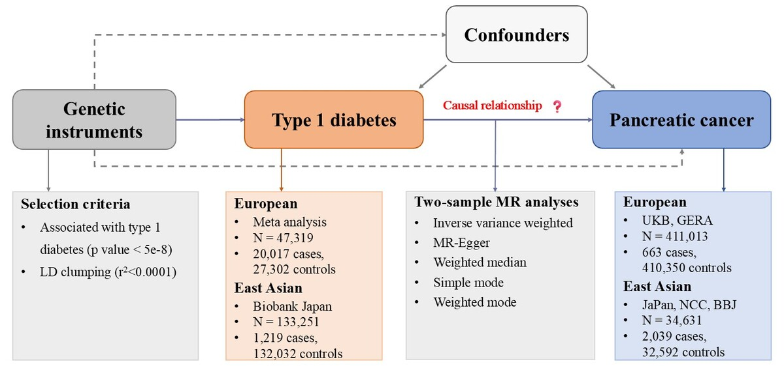

Causal association of type 1 diabetes with pancreatic cancer: a multi-ancestry Mendelian randomization study
DOI: 10.5114/aoms/220327
Arch Med Sci 2026;22(2):1218-1223
Notes:
Introduction
Material and methods
Results
Conclusions

