Slide 1
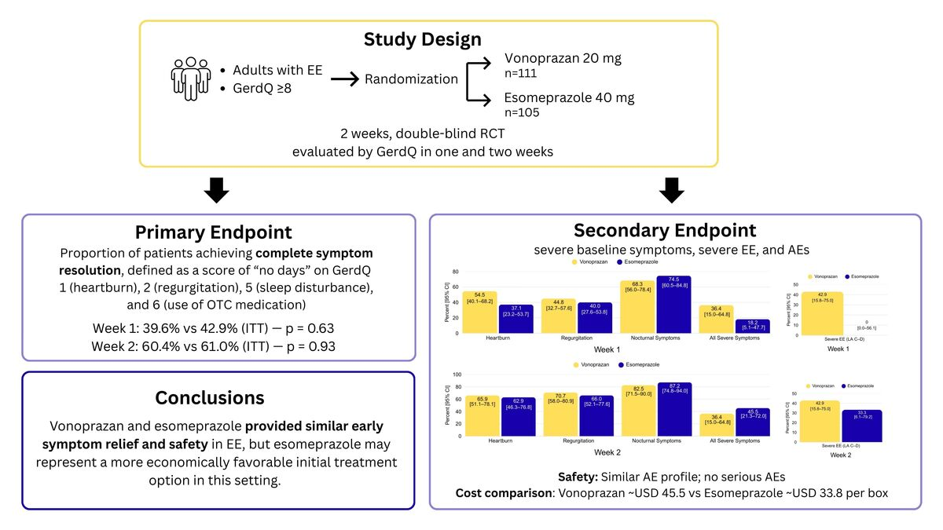

Efficacy and Safety of Vonoprazan vs Esomeprazole for Early Symptom Relief in Erosive Esophagitis: A 2-Week, Double-Blind Randomized Trial Using GerdQ
DOI: 10.5114/aoms/220329
Notes:
Introduction
This study compared the early symptom relief efficacy and safety of vonoprazan, a potassium-competitive acid blocker (P-CAB), and esomeprazole, a proton pump inhibitor (PPI), in patients with erosive esophagitis (EE). While PPIs are established treatments, P-CABs are a new option offering a faster onset of action.
Material and methods
In this multicenter, double-blind, randomized controlled trial, adults with Gastroesophageal Reflux Disease Questionnaire (GerdQ) scores ≥8 and endoscopy-confirmed EE received either vonoprazan 20 mg or esomeprazole 40 mg once daily for two weeks. The primary endpoint was complete resolution (CR) of symptoms at weeks 1 and 2 using GerdQ. Secondary endpoints included subgroup responses and safety.
Results
Among 216 participants (vonoprazan: 111; esomeprazole: 105), most had mild EE. At week 1, CR rates were 39.6% [95% CI: 31.0–48.9%] with vonoprazan and 42.9% [95% CI: 33.8–52.4%] with esomeprazole in the intention-to-treat (ITT) analysis, and 43.1% [95% CI: 33.9–52.8%] vs. 45.9% [95% CI: 36.4–55.8%] in the per-protocol (PP) analysis. At week 2, CR rates were 60.4% [95% CI: 51.1–69.0%] vs. 61.0% [95% CI: 51.4–69.7%] in ITT, and 66.3% [95% CI: 56.7–74.8%] vs. 66.0% [95% CI: 56.1–74.6%] in PP, with no significant between-group differences. Adverse events were similar, with nasopharyngitis, gastrointestinal symptoms, and headache/dizziness being the most frequent. No serious events occurred.
Conclusions
Vonoprazan and esomeprazole demonstrated similar efficacy and safety profiles for early symptom relief in patients with EE. Given these comparable outcomes, esomeprazole may represent a more economical initial option based on short-term medication costs. (ClinicalTrials.gov; NCT06720610).

