Slide 1
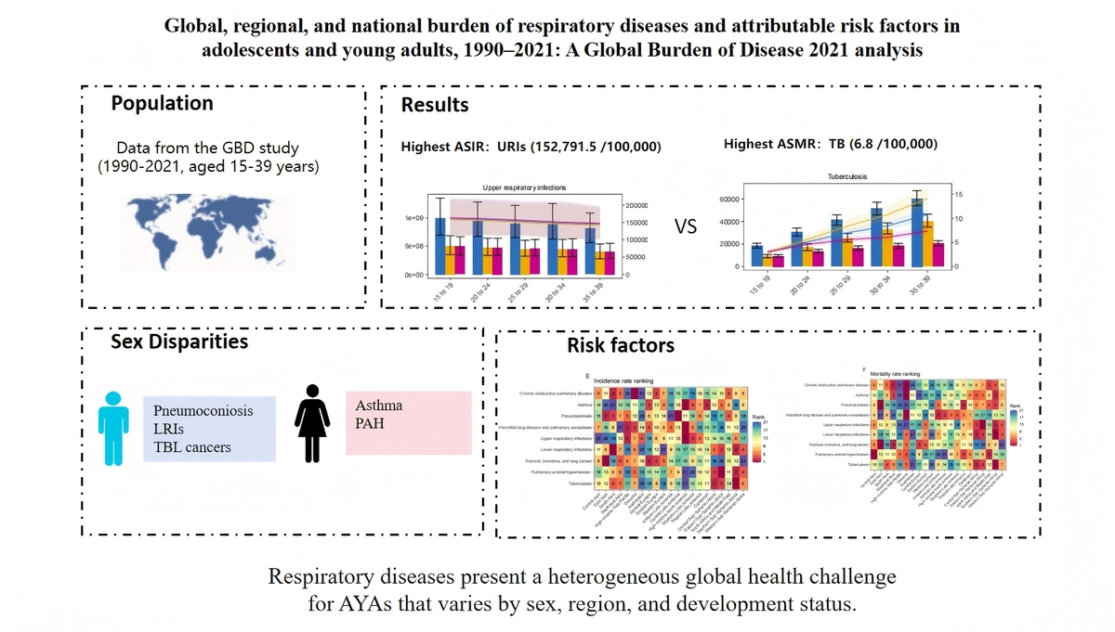

Global, regional, and national burden of respiratory diseases and attributable risk factors in adolescents and young adults, 1990–2021: a Global Burden of Disease 2021 analysis
DOI: 10.5114/aoms/220340
Arch Med Sci 2026;22(2):857-870
Notes:
Introduction
Respiratory diseases impose a substantial global burden on adolescents and young adults (AYAs, aged 15–39 years), yet this population remains undercharacterized.
Material and methods
Using Global Burden of Disease 2021 data, we assessed incidence, mortality, DALYs, and attributable risk factors for respiratory diseases among AYAs across 204 countries and territories. Estimates were stratified by age, sex, location, and sociodemographic index (SDI). Temporal trends were evaluated using estimated annual percentage change (EAPC), and associations with development were analyzed via LOESS regression (span = 0.5).
Results
In 2021, upper respiratory infections had the highest age-standardized incidence rate (152,791.5/100,000), while tuberculosis caused the highest age-standardized mortality rate (6.8/100,000). Air pollution was the leading risk factor, contributing to 32.76 age-standardized DALYs per 100,000 for chronic obstructive pulmonary disease (COPD) and 62.37 for lower respiratory infections (LRIs). Sex-based disparities were evident: males had higher burdens of pneumoconiosis, LRIs, and tracheal/bronchus/lung cancers, whereas asthma and pulmonary arterial hypertension were more prevalent in females. Regionally, low-SDI areas bore the greatest burden for TB and LRIs, while high-SDI regions had higher rates of URIs and asthma. Smoking was the primary driver of COPD burden specifically in high-income countries.
Conclusions
Respiratory diseases present a heterogeneous global health challenge for AYAs that varies by sex, region, and development status. These findings support targeted strategies: control of infectious disease and air quality improvement in low-SDI regions where TB and LRIs predominate, alongside enhanced asthma management and tobacco control in high-income areas where URIs and smoking-related COPD burden are more prevalent.

