Slide 1
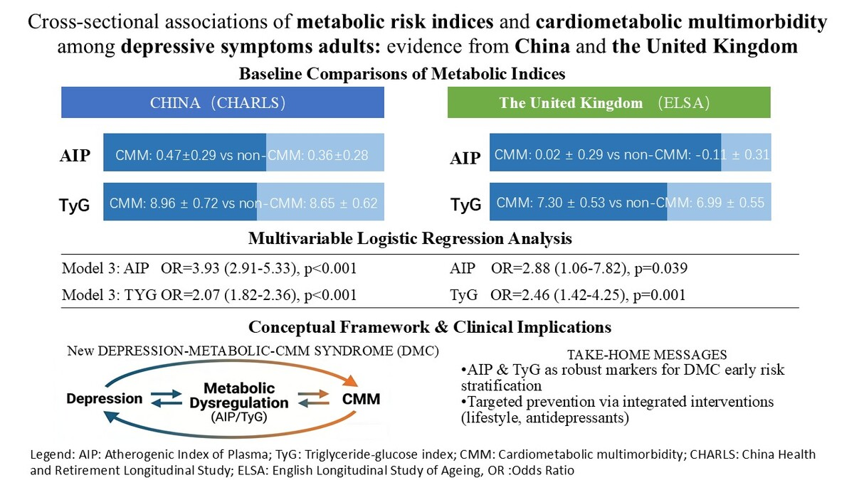

Cross-sectional associations of metabolic risk indices and cardiometabolic multimorbidity among adults with depressive symptoms: evidence from China and the United Kingdom
DOI: 10.5114/aoms/220465
Arch Med Sci 2026;22(3):1347-1358
Notes:
Introduction
Depression is associated with cardiovascular disease, but the impact of metabolic markers on cardiometabolic multimorbidity (CMM) remains unclear. We examined the atherogenic index of plasma (AIP) and triglyceride-glucose index (TyG) in relation to CMM risk in depressed adults from the China Health and Retirement Longitudinal Study (CHARLS) and the English Longitudinal Study of Ageing (ELSA).
Material and methods
We analyzed 3,225 depressed Chinese (CHARLS) and 353 UK (ELSA) individuals aged ≥ 50 years. CMM comprised diabetes, coronary heart disease, and stroke. Metabolic dysregulation was assessed using AIP and TyG indices. Multivariable logistic regression was used to examine the associations.
Results
In CHARLS, the CMM group had significantly higher AIP (0.47 ±0.29 vs. 0.36 ±0.28) and TyG (8.96 ±0.72 vs. 8.65 ±0.62) than the non-CMM group (p < 0.001). In Model 3, each unit increase in AIP was associated with CMM risk (OR = 3.93, 95% CI: 2.91–5.33, p < 0.001), similarly for TyG (OR = 2.07, 95% CI: 1.82–2.36, p < 0.001). In the ELSA validation cohort, the CMM group also had higher TyG (p < 0.001) and AIP (p = 0.004). In Model 3, each unit increase in TyG was associated with CMM (OR = 2.46, 95% CI: 1.42–4.25, p = 0.001), similarly for AIP. Restricted cubic spline analysis showed a dose–response relationship.
Conclusions
AIP and TyG are independent predictors of CMM in depressed adults across different cultural contexts. These indices are promising, accessible tools for early risk stratification and targeted intervention to manage cardiometabolic multimorbidity in depression.

