Slide 1
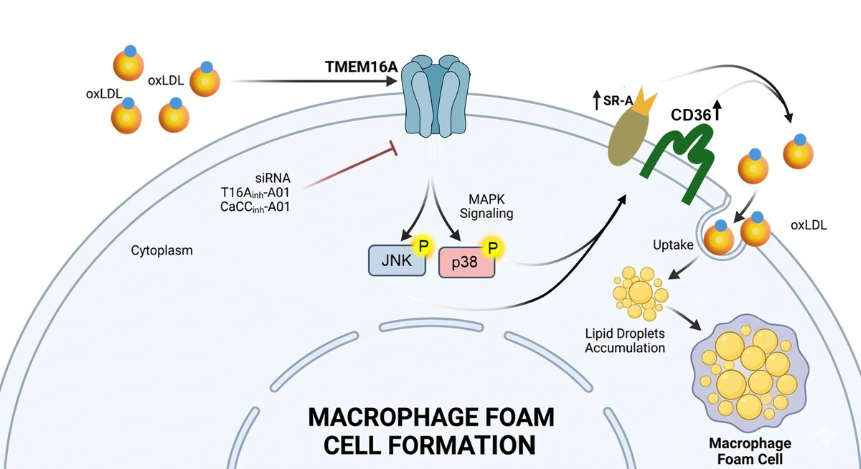

TMEM16A contributes to oxLDL-induced macrophage foam cell formation via the p38/JNK MAPK signaling pathways
DOI: 10.5114/aoms/220490
Notes:
Introduction
Atherosclerotic cardiovascular disease remains the leading cause of global mortality, characterized by lipid accumulation and inflammatory cell infiltration within the arterial wall. A critical early event in atherogenesis is the formation of macrophage foam cells driven by excessive uptake of oxidized low-density lipoprotein (oxLDL). While cations such as Ca²+ have been extensively studied in this context, the role of Cl- as a regulatory anion in foam cell formation remains poorly understood. The calcium-activated chloride channel TMEM16A plays an important role in many physiological processes. However, its role in macrophages remains unclear.
Material and methods
Macrophage cells were treated with oxLDL to induce foam cell formation. TMEM16A expression was modulated by siRNA-mediated knockdown or cDNA-driven overexpression, and its activity was pharmacologically inhibited using T16Ainh-A01 and CaCCinh-A01. Expression of scavenger receptor A (SR-A) and CD36, phosphorylation level of JNK, and p38 MAPK signaling pathways were analyzed by Western blotting to elucidate underlying mechanisms.
Results
OxLDL treatment significantly increased TMEM16A expression in RAW264.7 and THP-1 macrophages. Genetic silencing or pharmacological inhibition of TMEM16A markedly attenuated oxLDL-induced lipid accumulation and foam cell formation, whereas TMEM16A overexpression promoted oxLDL accumulation in macrophages. Mechanistically, TMEM16A deficiency significantly reduced SR-A and CD36 expression, which was associated with decreased phosphorylation of JNK and p38 MAPK, indicating that TMEM16A regulates SR-A and CD36 through a MAPK-dependent signaling pathway.
Conclusions
These findings demonstrate that TMEM16A plays a critical role in macrophage derived foam cell formation by promoting oxLDL uptake through activation of the JNK/p38–SR-A/CD36 axis. Targeting TMEM16A could be a promising therapeutic strategy for atherosclerosis.

