Slide 1
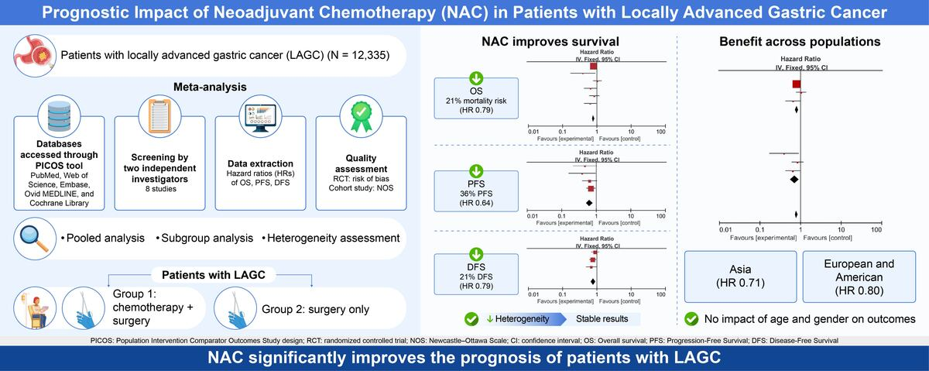

Prognostic impact of neoadjuvant chemotherapy in patients with locally advanced gastric cancer: a systematic review and meta-analysis
DOI: 10.5114/aoms/220491
Notes:
Introduction
Previous studies have reported conflicting results regarding the efficacy of neoadjuvant chemotherapy (NAC) for locally advanced gastric cancer (LAGC). This may be attributable to limited sample sizes. Therefore, this meta-analysis aimed to synthesize existing evidence from relevant studies to provide robust conclusions.
Methods
A comprehensive literature search was conducted across five authoritative databases. Studies meeting predefined inclusion and exclusion criteria were selected, and the quality of included studies was subsequently assessed. Following data extraction, pooled effect estimates were calculated. Sensitivity analysis was used to evaluate the robustness of the findings, and funnel plots were gen-erated to assess publication bias. Meta-regression was performed to explore potential sources of heterogeneity, and exploratory subgroup analyses were ultimately conducted.
Results
Eight included studies demonstrated good quality, with no substantial heterogeneity observed between them. The results indicated that NAC significantly improved survival outcomes in patients with LAGC. Specifically, for overall survival (OS), hazard ratio (HR) = 0.79, 95% confidence interval (CI) = 0.73–0.86, Z = 5.25, and p < 0.00001. For progression-free survival, HR = 0.64, 95% CI = 0.50–0.81, Z = 3.74, and p = 0.002. For disease-free survival, HR = 0.79, 95% CI = 0.67–0.92, Z = 2.99, and p = 0.003. The findings were robust, and no substantial publication bias was detected. Meta-regression analyses indicated that variations in population, age, and sex did not markedly influence survival outcomes. Subgroup analysis of OS based on population revealed that NAC improved prognosis for both European/American (HR = 0.80, 95% CI = 0.73–0.88, Z = 4.62, and p < 0.00001) and Asian (HR = 0.71, 95% CI = 0.55–0.91, Z = 2.66, and p = 0.008) patients with LAGC.
Conclusions
NAC markedly improves the prognosis of patients with LAGC.

