Slide 1
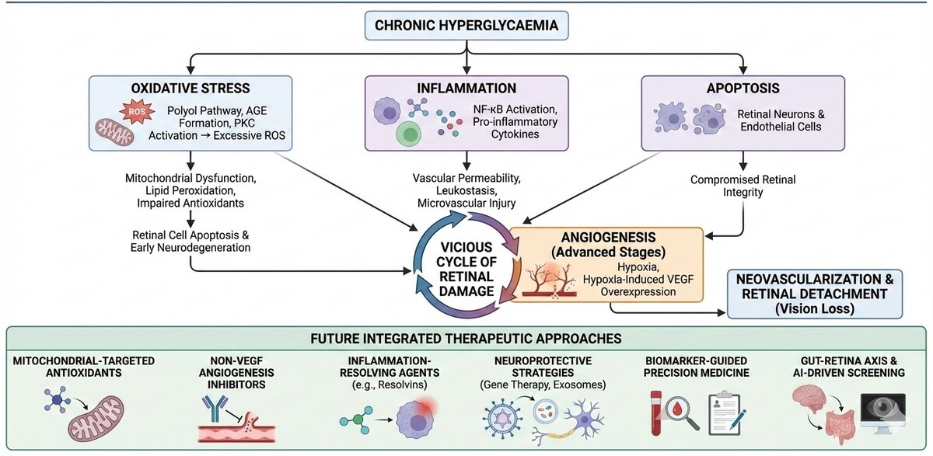

Molecular and cellular crosstalk in the pathogenesis of diabetic retinopathy
DOI: 10.5114/aoms/220653
Notes:
Diabetic retinopathy is a major cause of vision loss worldwide and arises from interconnected molecular mechanisms involving oxidative stress, inflammation, apoptosis, and angiogenesis. Chronic hyperglycaemia induces excessive reactive oxygen species production through pathways such as advanced glycation end-product formation and protein kinase C activation, leading to mitochondrial dysfunction, impaired antioxidant defences, and retinal cell apoptosis. In parallel, activation of inflammatory signalling cascades, including NF-κB–mediated cytokine release, promotes leukostasis, vascular permeability, and microvascular injury. Progressive neuronal and endothelial apoptosis further disrupts retinal integrity. At later stages, sustained hypoxia triggers VEGF overexpression and pathological angiogenesis. These processes reinforce one another, creating a self-amplifying pathogenic cycle. Effective disease control therefore requires integrated strategies that address multiple pathways simultaneously, including modulation of oxidative stress, suppression of chronic inflammation, preservation of retinal neuronal survival, and regulation of aberrant angiogenic signalling. Targeting shared upstream drivers is critical for slowing progression and limiting irreversible retinal damage.

