Slide 1
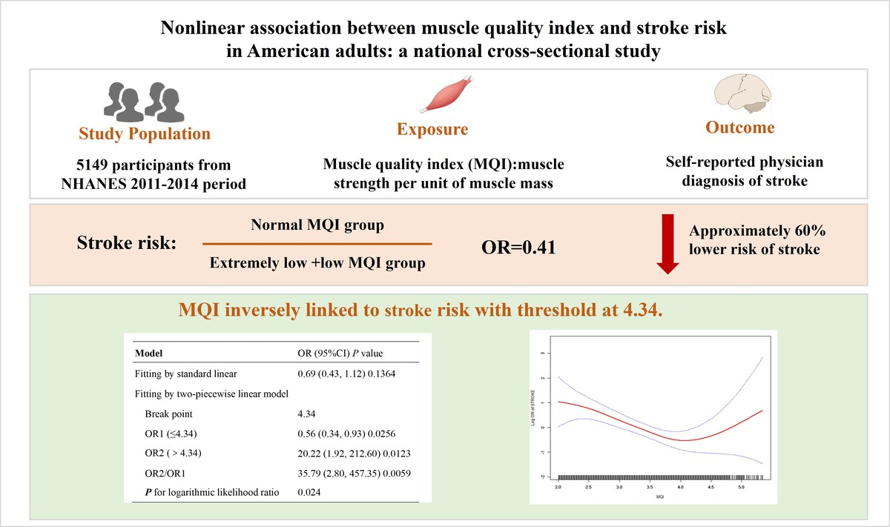

Nonlinear association between muscle quality index and stroke risk in American adults: a national
cross-sectional study
DOI: 10.5114/aoms/220750
Arch Med Sci 2026;22(2):1212-1217
Notes:
Introduction
Material and methods
Results
Conclusions

