Slide 1
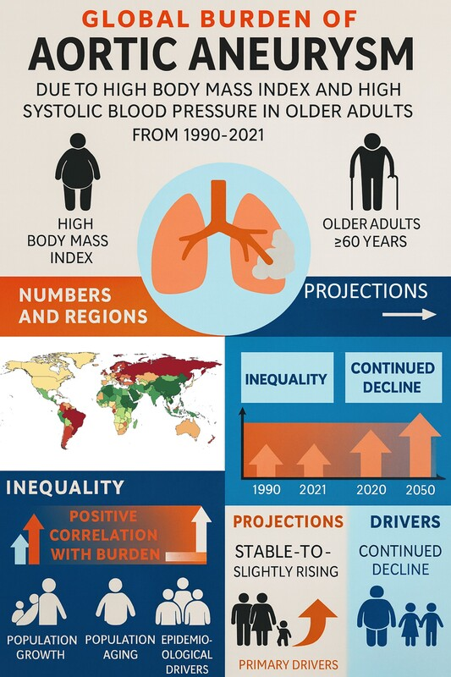

Global burden of aortic aneurysm from high body mass index and systolic blood pressure in older adults: 1990–2021 and projections to 2050
DOI: 10.5114/aoms/220767
Arch Med Sci 2026;22(3):1292-1302
Notes:
Introduction
Aortic aneurysm is a life-threatening vascular condition with a high case-fatality rate, yet the specific contributions of modifiable risk factors to its burden in the rapidly growing population of older adults remain poorly quantified. This study aimed to quantify the mortality and disability burden of aortic aneurysm attributable to high body mass index and high systolic blood pressure in adults aged 60 years and older from 1990 to 2021, and to project future trends to 2050.
Material and methods
Using data from the Global Burden of Disease (GBD) 2021 study, we analysed deaths and disability-adjusted life-years (DALYs) across 204 countries and territories. We assessed socio-demographic inequality using the slope index of inequality and concentration index, decomposed changes into demographic and epidemiological drivers, and projected future trends using Bayesian age-period-cohort models. Trends are reported as average annual percentage changes with 95% uncertainty intervals (UIs) or confidence intervals (CIs).
Results
In 2021, high body mass index (BMI) accounted for 9,476 deaths (95% UI: 4,908–16,032) and 164,396 DALYs (86,431–277,024) globally (age-standardised death rate (ASDR) = 0.91; age-standardised DALY rate 15.33 per 100,000). High SBP accounted for 23,131 deaths (16,746–30,145) and 385,281 DALYs (281,872–495,327) (ASDR = 2.24; DALY rate 36.17 per 100,000). Burden was highest in Eastern Europe and lowest in East Asia; men exceeded women across ages. From 1990 to 2021, AAPC declined for high BMI (deaths –1.10; DALYs –1.13) and more steeply for high SBP (deaths –1.67; DALYs –1.70). Socioeconomic inequality narrowed over time. Projections to 2050 indicate rising absolute counts due to population ageing, despite stable or declining rates.
Conclusions
These findings support strengthened hypertension control and sustained obesity prevention, particularly in older men and high-burden regions, alongside improved access to screening and vascular care.

