Slide 1
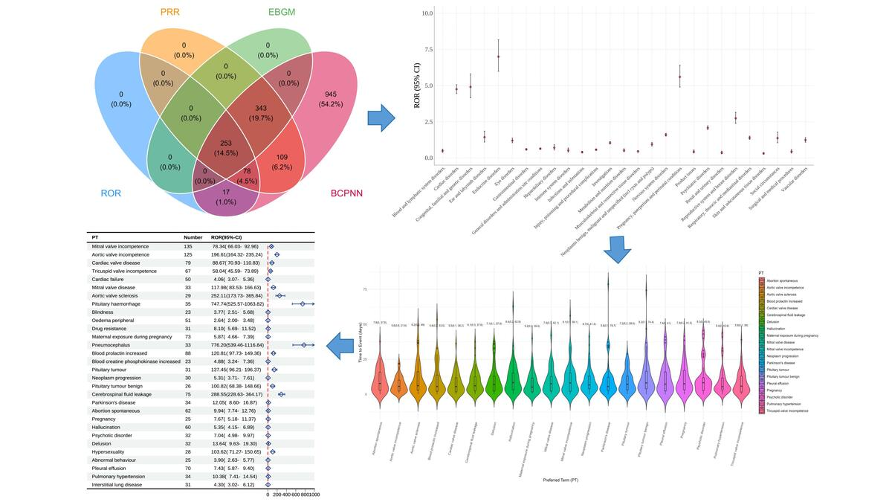

A real-world pharmacovigilance analysis of cardiac, endocrine, and neurological adverse events associated with cabergoline: a disproportionality study
DOI: 10.5114/aoms/221117
Arch Med Sci 2026;22(2):1224-1233
Notes:
Introduction
Material and methods
Results
Conclusions

