Slide 1
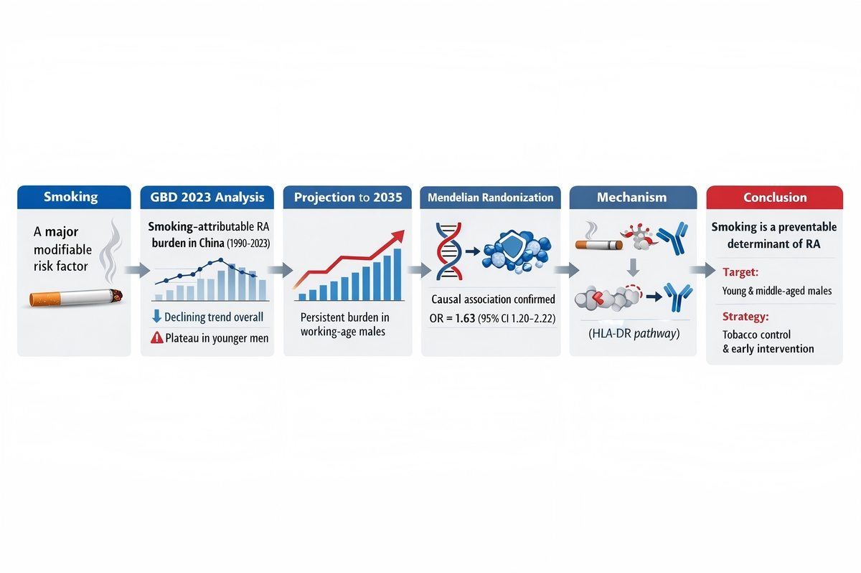

Smoking as a determinant of rheumatoid arthritis: integrated evidence from epidemiological patterns, genetic signals, and mechanistic insights
DOI: 10.5114/aoms/221185
Arch Med Sci 2026;22(2):1234-1238
Notes:
Introduction
Material and methods
Results
Conclusions

