Slide 1
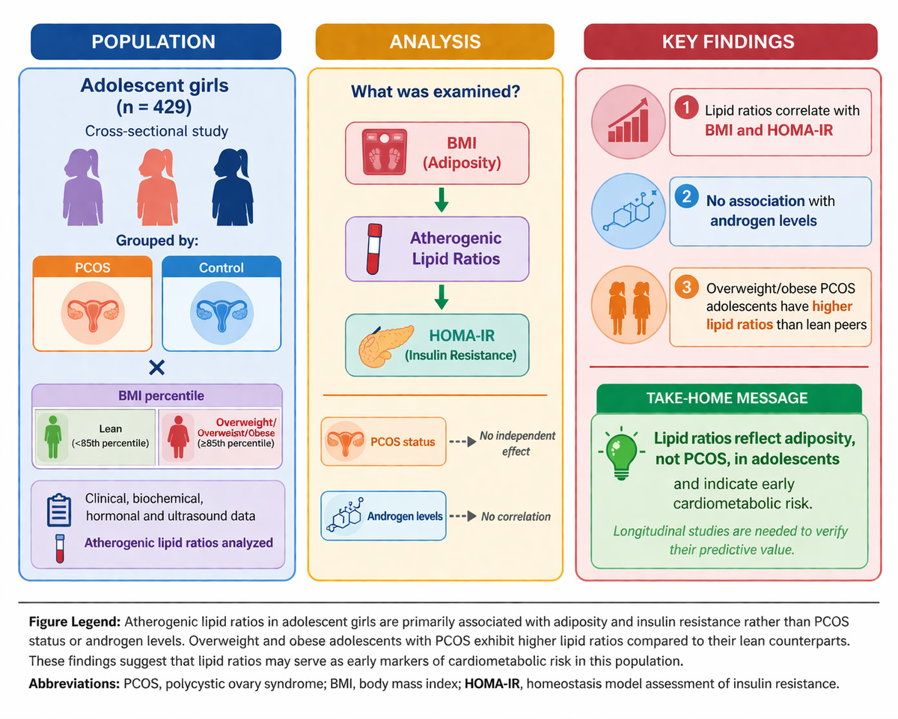

Atherogenic lipid ratios and insulin resistance primarily reflect adiposity rather than androgen status in adolescents with polycystic ovary syndrome: evidence from a large case-control cohort
DOI: 10.5114/aoms/221186
Arch Med Sci 2026;22(2):1206-1211
Notes:
Introduction
Material and methods
Results
Conclusions

