Slide 1
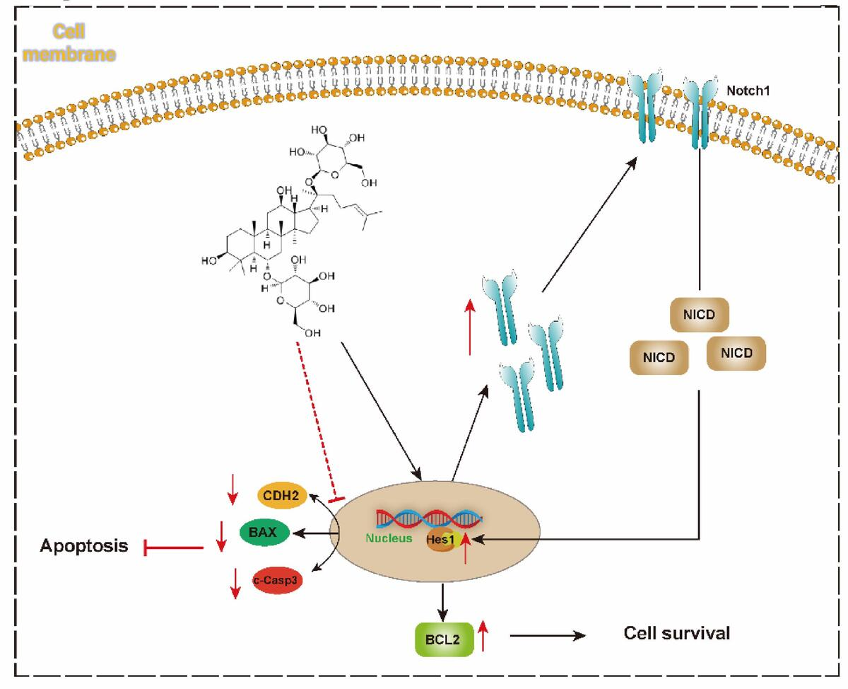

Ginsenoside Rg1 attenuates inflammatory injury and apoptosis in autoimmune thyroiditis by reshaping the Notch1/Hes1–CDH2 axis
DOI: 10.5114/aoms/221197
Notes:
Introduction
This study aimed to determine whether ginsenoside Rg1(Rg1) alleviates inflammation and apoptosis in autoimmune thyroiditis (AIT) by remodeling the Notch1/Hes1 signaling pathway, and to evaluate the potential of this pathway as a therapeutic target.
Material and methods
Differentially expressed genes (DEGs) were identified from the GSE269497 bulk RNA-seq dataset and intersected with Notch1/Hes1 pathway gene sets to screen for candidate molecules. A protein–protein interaction network, CIBERSORT immune infiltration analysis, gene set enrichment analysis (GSEA), and gene set variation analysis (GSVA) were conducted to characterize CDH2-related immune and pathway features. Public GWAS/eQTL datasets were integrated using two-sample Mendelian randomization (MR) to evaluate the causal relationship between candidate genes and AIT risk. Single-cell RNA sequencing data from GSE163203 were used to analyze the cell-type-specific distribution of CDH2 in the thyroid microenvironment. In vitro validation was performed using CCK-8, RT-qPCR, and Western blot to assess cell viability, Notch1/Hes1 signaling, CDH2 levels, and apoptosis-related proteins.
Results
Transcriptomic analysis revealed disrupted Notch1/Hes1 signaling and significant upregulation of CDH2 in AIT. MR analysis indicated a positive causal relationship between genetically predicted CDH2 expression and AIT susceptibility. Elevated CDH2 expression correlated with reduced regulatory T-cell infiltration and enrichment of pro-inflammatory and stress-related pathways, including complement/coagulation, oxidative phosphorylation, and proteasome activation. In vitro, inflammatory stimulation inhibited Notch1/Hes1 signaling, shifted the Bcl-2/Bax–caspase axis toward apoptosis, and increased CDH2 expression. Rg1 treatment restored Notch1/Hes1 activation, increased Bcl-2 expression, reduced Bax and cleaved caspase-3 levels, suppressed CDH2 expression, and improved cell viability.
Conclusions
Rg1 reduces inflammatory apoptosis and tissue damage in thyroid follicular cells during autoimmune thyroiditis (AIT) by reshaping the Notch1/Hes1–CDH2 axis, thereby enhancing pro-survival signals while inhibiting CDH2-mediated abnormal adhesion and pro-inflammatory activation. The Notch1/Hes1–CDH2 axis may serve as a potential target for mechanism-guided adjuvant therapy in AIT.

