Slide 1
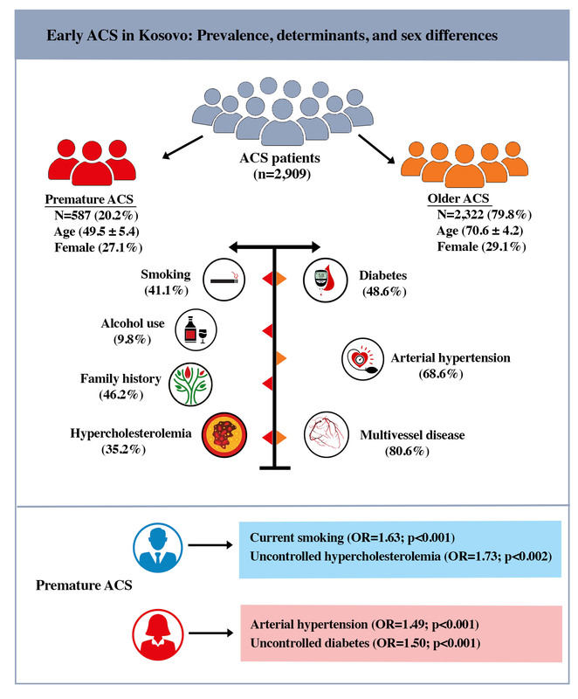

Prevalence and determinants of early acute coronary syndrome in Kosovo: a population-based study of sex-specific differences
DOI: 10.5114/aoms/221224
Notes:
Introduction
Acute coronary syndrome (ACS) in younger individuals represents an important and growing clinical challenge, and is associated with substantial long-term morbidity. This study aimed to evaluate the clinical characteristics and predictors of premature ACS, with particular emphasis on sex differences and cardiovascular (CV) risk factors.
Material and methods
We retrospectively analyzed 2,909 patients with ACS treated at the University Clinical Centre of Kosovo. Of these, 587 (20.2%) had premature ACS (men < 55 years; women < 65 years). Data on CV risk factors, electrocardiographic, echocardiographic, and angiographic findings, and medications were collected from medical records.
Results
Patients with premature ACS (mean age: 49.5 ±5.4 years, men: 72.9%) had a higher prevalence of hypercholesterolemia (35.2 vs. 25.1%; p < 0.001), uncontrolled hypercholesterolemia (40.4% vs. 26.9%; p < 0.001), current smoking (41.1% vs. 22.9%; p < 0.001) and family history of coronary artery disease (46.2% vs. 32.4%; p < 0.001), but a lower prevalence of diabetes, hypertension, and uncontrolled diabetes (all p < 0.001) compared with older patients. Among patients with premature ACS, women had lower rates of current smoking (35.2% vs. 46.9%; p = 0.01), alcohol consumption (2.9% vs. 14.7%; p < 0.001) and uncontrolled hypercholesterolemia (32.7% vs. 45.5%) but a higher prevalence of diabetes, uncontrolled diabetes, and hypertension compared with premature men. In multivariable analysis, current smoking (OR = 1.59; p < 0.001), uncontrolled hypercholesterolemia (OR = 1.71; p < 0.001), and family history (OR = 1.66; p < 0.001) were independently associated with premature ACS, irrespective of sex. In women, a more pronounced cardiometabolic profile was observed, with uncontrolled diabetes (OR = 1.51; p < 0.001) and hypertension (OR = 1.49; p < 0.001) as independent predictors. However, in men, premature ACS was mainly driven by smoking (OR = 1.63; p < 0.001) and uncontrolled hypercholesterolemia (OR = 1.73; p < 0.001).
Conclusions
Premature ACS, diagnosed in every fifth patient in Kosovo, is mainly associated with uncontrolled hypercholesterolemia and smoking, while diabetes, hypertension, and hyperglycemia are less common than in older patients. Clear sex differences were observed, with a more cardiometabolic profile in women and predominantly lifestyle-related risk factors in men. These findings highlight the distinct risk factor patterns in premature ACS and emphasize the importance of targeted prevention and early risk factor control in this population.

