Slide 1
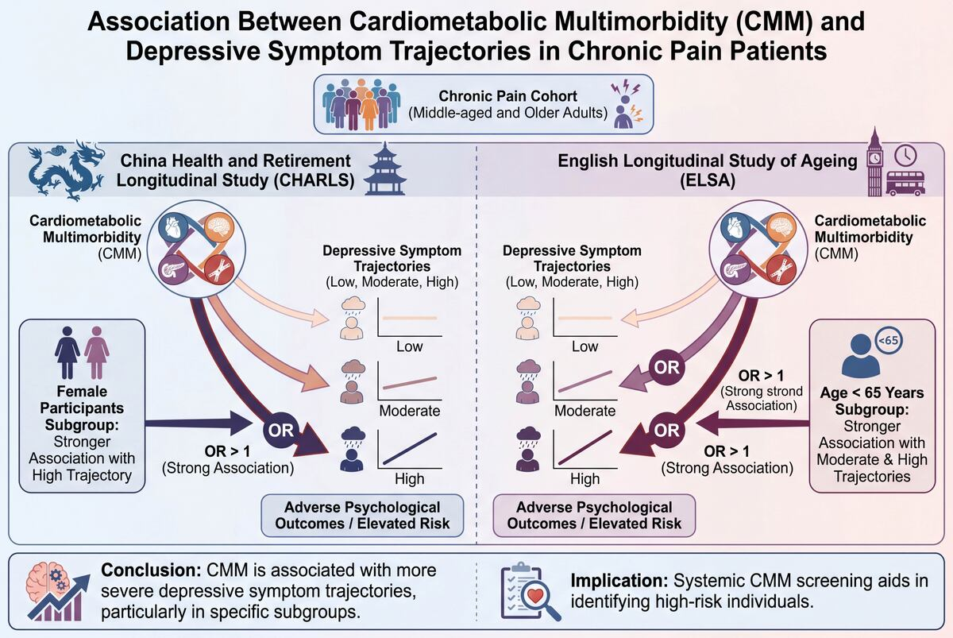

Cardiometabolic multimorbidity and depressive symptom trajectories in middle-aged and older adults with chronic pain: evidence from the CHARLS and ELSA cohorts
DOI: 10.5114/aoms/221240
Notes:
Introduction
The co-occurrence of chronic pain and cardiometabolic multimorbidity (CMM) is increasingly prevalent among middle-aged and older adults, yet the extent to which CMM shapes the longitudinal course of depressive symptomatology in this population remains poorly understood.
Material and methods
Data were drawn from the China Health and Retirement Longitudinal Study (CHARLS; participants aged 45 years and older) and the English Longitudinal Study of Ageing (ELSA; participants aged
50 years and older). Group-based trajectory modeling (GBTM) was applied to identify distinct depressive symptom trajectories, and multinomial logistic regression was used to examine associations between CMM and trajectory group membership, with subgroup analyses conducted to assess potential effect modification.
Results
Three stable depressive symptom trajectories were identified in both cohorts: persistently low-, moderate-, and high-symptom groups. In ELSA, CMM was significantly associated with both moderate- (OR = 1.56, 95% CI: 1.24–1.96) and high-symptom trajectories (OR = 2.20, 95% CI: 1.61–3.02) after full covariate adjustment. In CHARLS, the association was confined to the high-symptom trajectory (OR = 1.39, 95% CI: 1.03–1.86). Subgroup analyses indicated a more pronounced association among female participants in CHARLS and among those younger than 65 years in ELSA.
Conclusions
CMM is significantly associated with more severe depressive symptom trajectories among middle-aged and older adults with chronic pain, with cross-cohort heterogeneity reflecting differences in population characteristics and sociocultural context. These findings suggest that consideration of CMM may be useful in the clinical assessment of individuals with chronic pain and may help identify individuals at elevated risk for adverse psychological outcomes.

