Slide 1
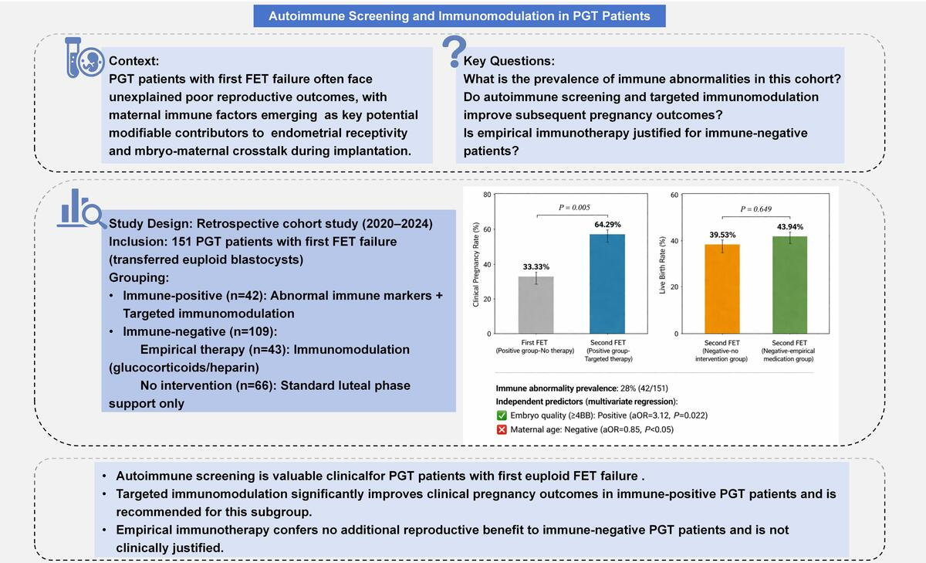

Value of autoimmune screening and immunomodulatory treatment to improve subsequent pregnancy outcomes in patients undergoing preimplantation genetic testing
DOI: 10.5114/aoms/221405
Notes:
Introduction
We aimed to evaluate the clinical utility of autoimmune screening and the effectiveness of immunomodulatory treatment in preimplantation genetic testing (PGT) patients.
Material and methods
In this retrospective cohort study, 151 PGT patients who experienced a failed first frozen embryo transfer (FET) were divided into two groups. Patients underwent immune marker screening before their second FET. Among them, 42 were classified into the immune-positive group and received targeted interventions, while 109 were categorized into the immune-negative group, which was further divided into an empirical medication subgroup (n = 43) and a no-intervention subgroup (n = 66). Baseline characteristics and pregnancy outcomes were analyzed using statistical methods, including univariate and multivariate logistic regression analyses.
Results
We found that among PGT patients with first transfer failure, 28% (42/151) showed abnormal immune markers. Targeted therapy in immune-positive patients was associated with significantly improved clinical pregnancy rates compared to their first unscreened cycle (64.29% vs. 33.33%, p = 0.005), while reducing the miscarriage rate. In contrast, empirical immunomodulation in immune-negative patients did not provide any additional benefit in terms of live birth rate (39.53% vs. 43.94%, p = 0.649). Multivariate analysis confirmed that embryo quality was an independent positive predictor of both hCG positivity (p = 0.034) and clinical pregnancy (p = 0.022), whereas maternal age showed an inverse association with the likelihood of success (p < 0.05).
Conclusions
Immune abnormalities are relatively prevalent in the PGT population. Targeted immunomodulatory interventions in immune-positive patients were associated with improved pregnancy outcomes. We recommend that these patients should undergo immune screening and targeted interventions before embryo transfer. However, empirical therapy in immune-negative individuals is unjustified.

