Slide 1
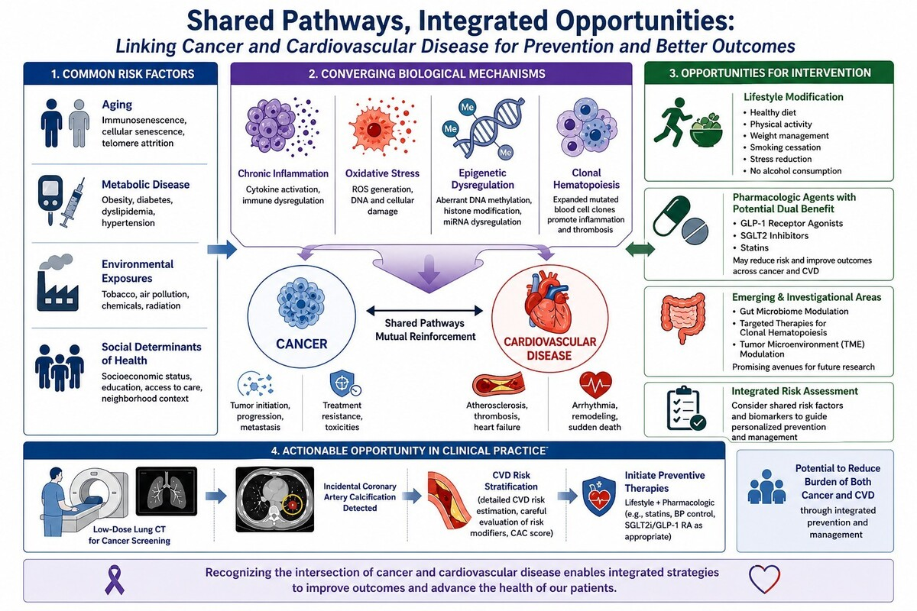

Cardiovascular disease in cancer patients: a neglected dimension of modern oncology
DOI: 10.5114/aoms/221422
Arch Med Sci 2026;22(2):782-784

