Slide 1
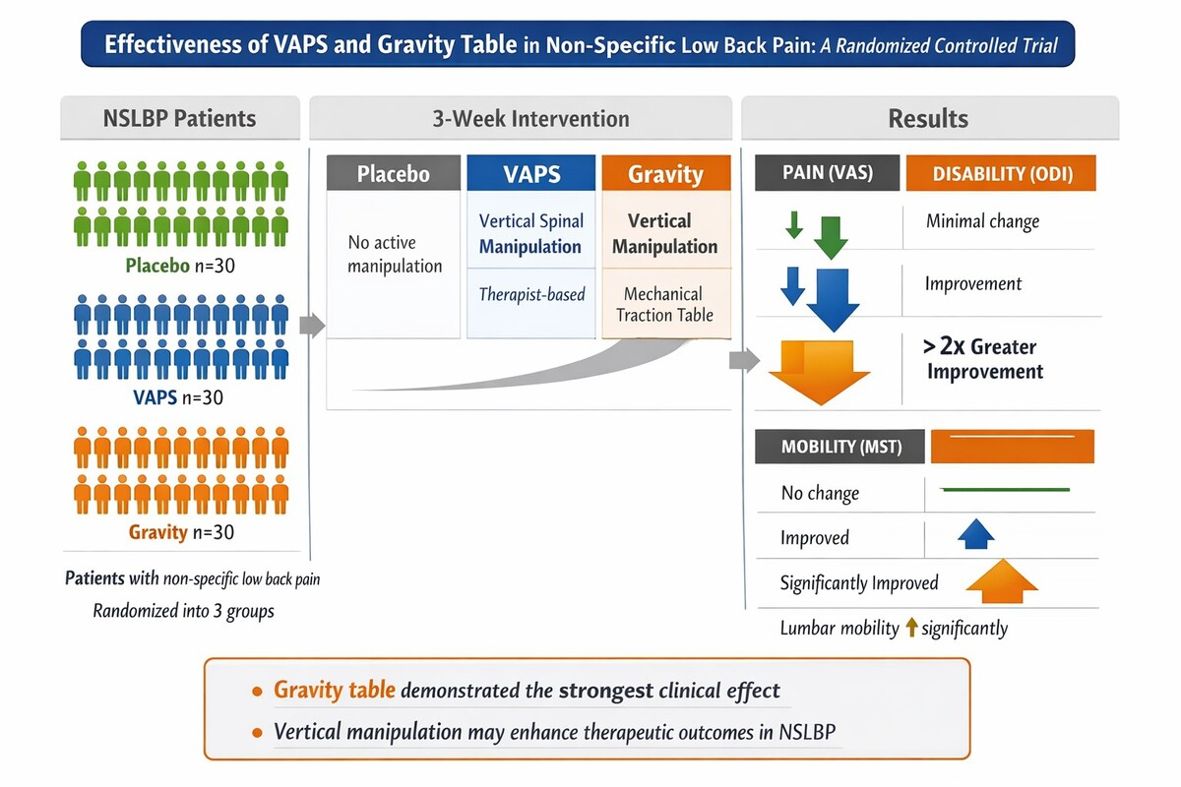

The efficacy of mechanical spinal manipulation in the standing position in patients with non-specific low back pain: a randomised placebo-controlled trial
DOI: 10.5114/aoms/221562
Arch Med Sci 2026;22(4):2184-2196
Notes:
Introduction
Non-specific low back pain (NSLBP) is not attributable to a known cause and is a leading contributor to the global disease burden. The effect of specific spinal manipulation in patients with NSLBP using the vertical adjustment position standing (VAPS) technique described by Hartman remains unclear. This technique is used to address spinal restrictions and improve mobility. The main aim of the study was to examine the immediate and medium-term effects of VAPS on pain (VAS), mobility of the lumbar spine (MSt), and pain-related disability (ODI) in patients with non-specific low back pain (NSLBP) using two types of spinal manipulation including the innovative Gravity Table.
Material and methods
All patients (n = 90) were randomly assigned to the VAPS intervention group (n = 30), the Gravity group (n = 30), or the placebo group (n = 30) that received sham manipulation. At intake (M1), the VAS, ODI, and MSt were assessed, and were reassessed 3 weeks later (M2). Immediately after M2, the VAPS (performed by a therapist or using the Gravity Table) or sham manipulation was performed, and VAS and MSt were measured (M3) (short-term effect). Three weeks later, VAS, ODI. and MSt were measured again (M4) (medium-term effect). This study was a randomised, single-blind, placebo-controlled clinical trial, conducted in Belgium. Inclusion criteria: either sex, age ≥ 18 years, diagnosed with non-specific low back pain (NSLBP), defined as pain in the area between the last rib and the gluteal folds that persists for at least 12 weeks without obvious radiological signs of abnormality or another known possible cause. Exclusion criteria: spine surgery, use of specific medications (e.g. cortisone, anticoagulants), pregnancy, previous abdominal surgery within the last 3 months, acute illness during the study, contraindications (e.g. vertebral fractures, tumours, acute illnesses in the lumbar region and sacrum, osteoporosis, pathologic lordosis or kyphosis), and diseases of the central nervous system (e.g. multiple sclerosis, pyramidal, extrapyramidal or cerebellar disease).
Results
All subjects who met the inclusion criteria received the participant information sheet (“information part”), was informed about the possibility of withdrawing from the study at any stage of its duration, and provided informed consent. In the Gravity group, the greatest reduction in the level of pain was achieved, from 4.6 ±1.9 (M1) to 1.9 ±2.0 (M4) on the VAS scale. Analyses of ODI_M2 vs ODI_M4 indicated a significant reduction in the level of disability in the compared groups, and the lowest results were recorded in the group with the Gravity intervention (ODI_M2: 7.7 ±6.2; ODI_M4: 4.2 ±4.0; p < 0.001).
Conclusions
VAPS (performed by a therapist or using the Gravity Table) significantly improved pain (VAS) and MSt. A larger sample size may be needed to detect a significant effect on ODI.

