Slide 1
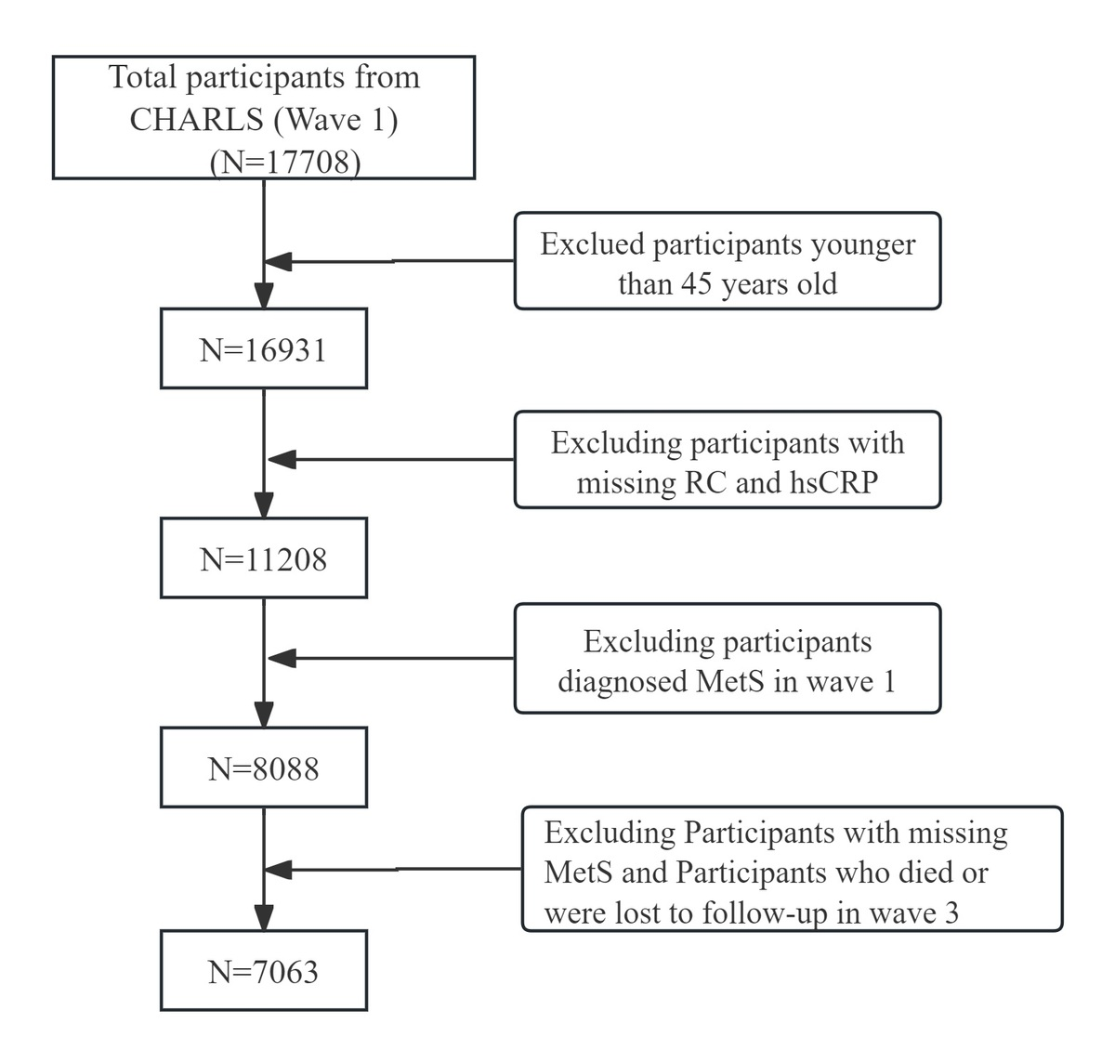

Association of combined high-sensitivity C-reactive protein and residual cholesterol levels with new-onset metabolic syndrome
DOI: 10.5114/aoms/221685
Notes:
Introduction
Metabolic syndrome (MetS) involves dyslipidaemia and inflammation. However, the joint association of high-sensitivity C-reactive protein (hsCRP) and residual cholesterol (RC) with the risk of MetS remains unclear.
Material and methods
This longitudinal study enrolled 7,063 participants from the China Health and Retirement Longitudinal Study (CHARLS). Participants were grouped by median RC (17 mg/dl) and hsCRP threshold (1 mg/l). Multivariate logistic regression and restricted cubic spline (RCS) analyses were used to evaluate the joint association of RC and hsCRP with the risk of MetS.
Results
During the 4-year follow-up period, 920 participants (11.5%) developed new-onset MetS. Compared with the group with low RC and low hsCRP, the fully adjusted odds ratio (OR) was 1.43 (p = 0.005) for the high RC only group and 2.56 (p < 0.001) for the group with both elevated levels, with a significant trend (p < 0.001). The residual cholesterol inflammation index (RCII) was positively associated with incident MetS risk. The fully adjusted OR (with 95% confidence interval [CI]) for quartile (Q) 4 vs. Q1 was 2.52 (1.92–3.30, p < 0.001), with a non-linear trend (p < 0.001). This association was consistent across age, sex, and BMI subgroups (all p for interaction > 0.05) and remained robust after excluding participants taking lipid-lowering drugs and using multiple imputation.
Conclusions
Elevated hsCRP and RC were independently and synergistically associated with a higher MetS risk. Combined evaluation of inflammatory and lipid-related markers may help identify individuals at increased risk of MetS. The findings provide further evidence of the association between these pathways and MetS development.

