Slide 1
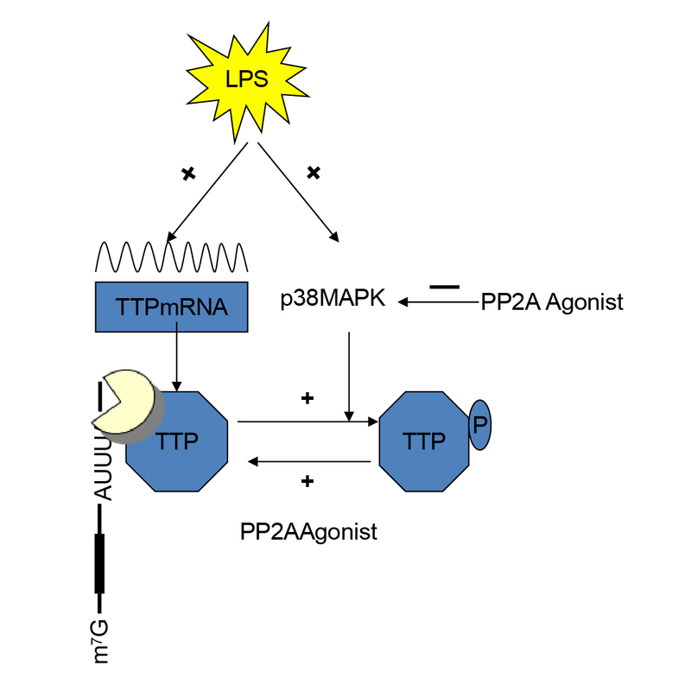

FTY720 attenuates LPS-induced acute lung injury through PP2A- tristetraprolin–dependent anti-inflammatory signaling
DOI: 10.5114/aoms/221775
Notes:
Introduction
Acute lung injury (ALI) is characterized excessive inflammatory signaling and uncontrolled cytokine production. Tristetraprolin (TTP) is a key post-transcriptional regulator of inflammatory cytokines that negatively regulates inflammatory pathways. PP2A emerges as an important player to activate TTP. However, whether pharmacological activation of PP2A can restore TTP activity and thereby attenuate ALI remains unexplored.
Material and methods
A lipopolysaccharide (LPS)-induced mice model of ALI and LPS-stimulated RAW264.7 macrophages were used to evaluate the effects of FTY720 or siRNA PP2A. Lung injury and inflammation were assessed by histopathology, wet-to-dry weight ratio, bronchoalveolar lavage fluid analysis, and cytokine quantification. PP2A activity, p38 MAPK and TTP phosphorylation, and gene expression were analyzed using phosphatase assays, Western blot, ELISA, and quantitative RT-PCR.
Results
Pretreatment of FTY720, a well-established PP2A activator, significantly alleviated LPS-induced lung injury, inflammatory cell infiltration, and inflammatory cytokines release in vivo. Treatment with PP2A siRNA blocked the improvement effect induced by FTY720 in LPS-induced lung injury mice. LPS exposure significantly impaired PP2A activity without altering PP2A protein abundance, whereas FTY720 restored PP2A activity in lung tissues. Mechanistically, PP2A activation suppressed p38 MAPK phosphorylation and/or promoted dephosphorylation of TTP in LPS-induced macrophages. Moreover, PP2A activation by FTY720 inhibited p38 MAPK and TTP phosphorylation without affecting TTP transcription, leading to reduced inflammatory cytokine production.
Conclusions
Our findings demonstrate that PP2A activation blocked inflammatory responses by reprogramming the TTP activity. Pharmacological targeting of PP2A may represent a promising strategy for the treatment of acute lung injury.

