Slide 1
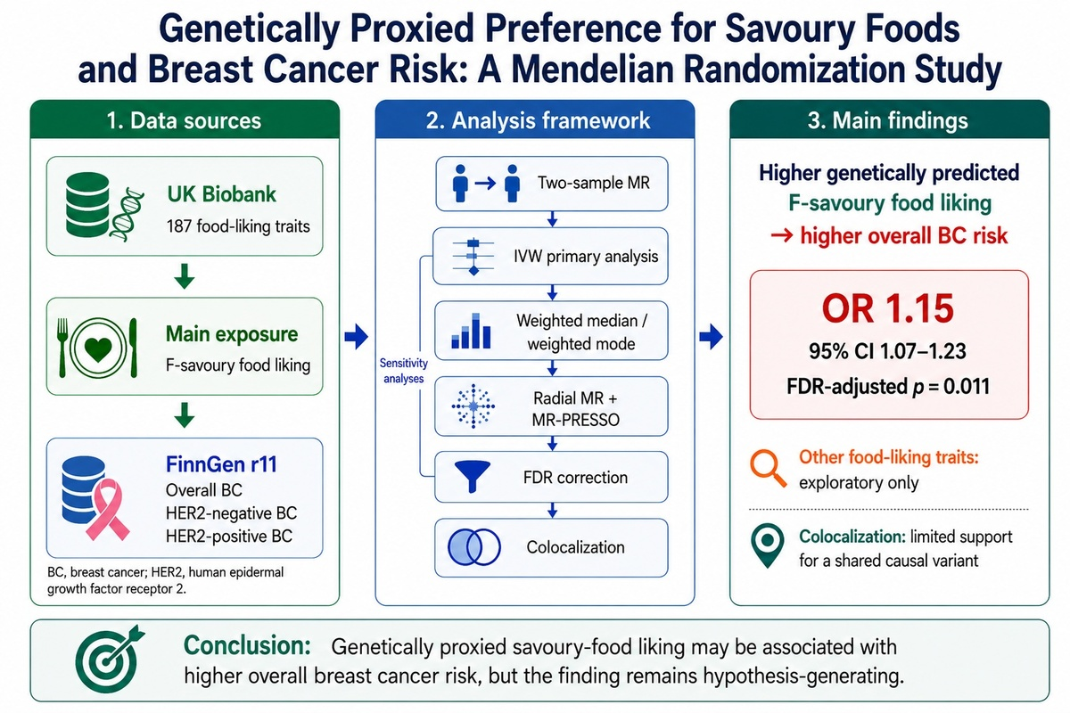

Genetically proxied preference for savoury foods and breast cancer risk: a Mendelian randomisation study
DOI: 10.5114/aoms/221776
Arch Med Sci 2026;22(3):1901-1904
Notes:
Introduction
Material and methods
Results
Conclusions

