Slide 1
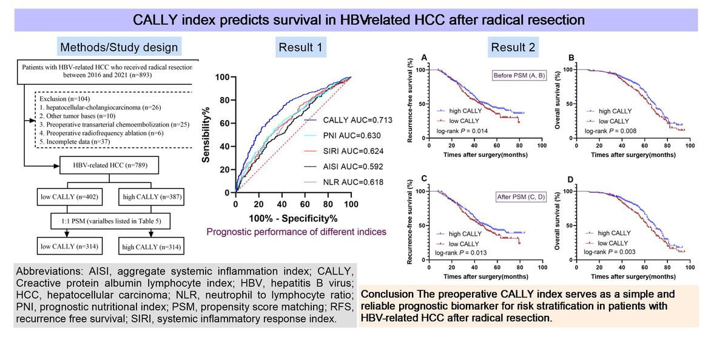

The C-reactive protein-albumin-lymphocyte (CALLY) index predicts survival in hepatitis B-related hepatocellular carcinoma after radical resection: a propensity score-matched analysis in a Chinese cohort
DOI: 10.5114/aoms/221897
Notes:
Introduction
The C-reactive protein–albumin–lymphocyte (CALLY) index has emerged as a promising prognostic tool in various malignancies, yet its role in patients with hepatitis B virus (HBV)-related hepatocellular carcinoma (HCC) remains underexplored. This study aimed to evaluate the association between the preoperative CALLY index and survival outcomes following radical resection in Chinese patients with HBV-related HCC.
Material and methods
In this retrospective cohort study, we included 789 Chinese patients with HBV-related HCC who underwent radical resection. Recurrence free survival (RFS) and overall survival (OS) were assessed using Kaplan–Meier analysis. Multivariable Cox regression and propensity score matching (PSM) were employed to identify independent prognostic factors and minimize confounding bias.
Results
The CALLY index was identified as an independent prognostic factor for both RFS and OS. Compared with the low-CALLY group, the high-CALLY group demonstrated significantly superior 1-, 3-, and 5-year RFS (96.3%, 65.7%, and 43.8% vs. 95.3%, 57.6%, and 35.0%, respectively; P = 0.014) and OS (98.5%, 91.0%, and 66.6% vs. 97.9%, 89.4%, and 56.9%; P = 0.008). These survival benefits remained statistically significant following propensity score matching (PSM) adjustment.
Conclusions
A high preoperative CALLY index is strongly associated with improved survival after radical resection in patients with HBV-related HCC, supporting its utility as an easily accessible prognostic biomarker for clinical risk stratification.

