Slide 1
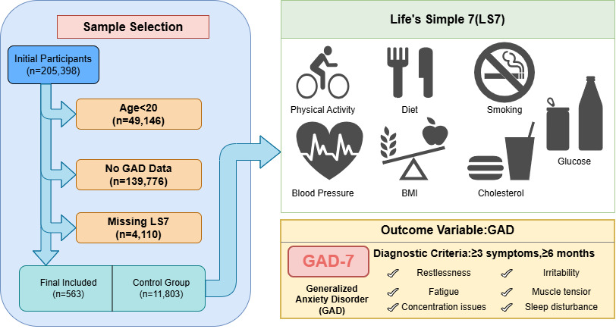

The Relationship Between Life’s simple 7 and Generalized Anxiety Disorder: A Study Based on KNHANES and Machine Learning
DOI: 10.5114/aoms/221898
Notes:
Introduction
This study aimed to investigate the relationship between LS7 scores and GAD risk in a nationally representative Korean population.
Material and methods
This study included 12,366 participants from 2001, 2005, 2007–2023 cycles of the Korean National Health and Nutrition Examination Survey (KNHANES). Propensity score matching (1:1) balanced baseline characteristics between GAD and non-GAD groups. Logistic regression analysis examined the association between LS7 and GAD across three models. XGBoost combined with SHAP analysis identified key variables associated with GAD. Restricted cubic spline analysis explored potential nonlinear dose response relationships. Sensitivity analysis using complete case analysis was conducted to assess the robustness of the findings.
Results
After propensity score matching (N = 1,126), the LS7 score was significantly lower in the GAD group than in the Normal group (9.35 ± 1.77 vs. 9.65 ± 1.72, P = 0.004). Logistic regression demonstrated a significant inverse association between LS7 and GAD risk (Model 1: OR = 0.88, 95% CI: 0.82–0.95, P < 0.001), with a significant dose-response trend (P for trend = 0.002). SHAP analysis identified LS7 as a key contributing feature (mean SHAP value = 0.044). Restricted cubic spline analysis confirmed a significant overall inverse association (P for overall < 0.001) with no significant nonlinear relationship detected (P for nonlinear = 0.426), and a notable inflection point observed at an LS7 score of 10. Sensitivity analysis yielded consistent results.
Conclusions
A negative correlation exists between LS7 and generalized anxiety. Optimizing the risk factors covered by LS7 may help improve and prevent GAD.

