Slide 1
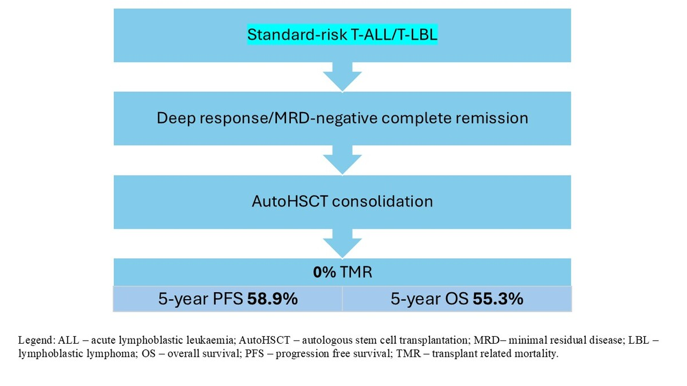

Autologous haematopoietic stem cell transplantation in standard-risk T-cell acute lymphoblastic leukaemia/lymphoma with negative residual disease status
DOI: 10.5114/aoms/221899
Arch Med Sci 2026;22(3):1905-1908
Notes:
Introduction
Material and methods
Results
Conclusions

