Slide 1
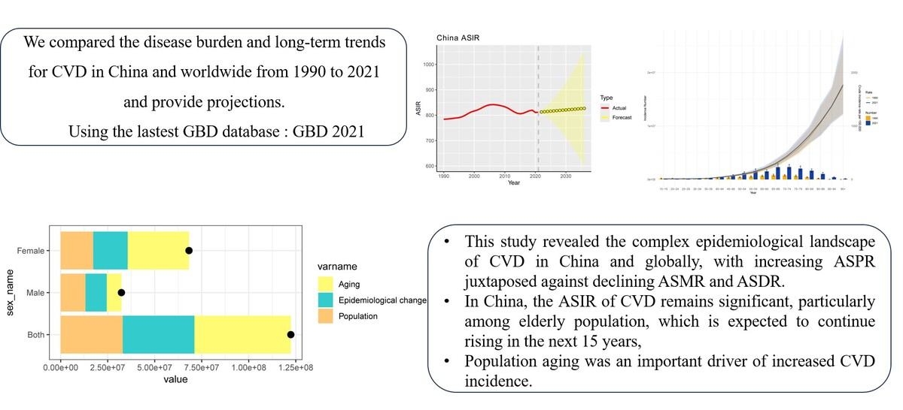

Temporal trends and decomposition analysis of cardiovascular disease burden in China and worldwide from 1990 to 2021, with projections to 2036
DOI: 10.5114/aoms/221929
Arch Med Sci 2026;22(4):1933-1947
Notes:
Introduction
Cardiovascular disease (CVD) is a major public health concern, and its burden and trends require further clarification. This study aimed to compare the CVD burden between China and the global population and provide projections.
Material and methods
Data on CVD metrics from the Global Burden of Disease (GBD) 2021. The Joinpoint regression model was applied to analyze long-term trends in age-standardized incidence (ASIR), prevalence (ASPR), mortality (ASMR), and age-standardized disability-adjusted life year (ASDR) rates. Decomposition analysis quantified drivers of change, and autoregressive integrated moving average models projected future trends.
Results
From 1990 to 2021, ASMR and ASDR showed significant downward trends in China and globally. However, the ASIR for CVD in China increased from 783.897 to 811.813 per 100,000, while globally it declined from 878.787 to 787.04 per 100,000, with average annual percent change of 0.105% (95% CI: 0.067%, 0.144%) and –0.353% (95% CI: –0.404%, –0.301%), respectively. The upward trend of ASPR in China exceeded the global level. The crude rates of CVD metrics were low among individuals younger than 40 years and then increased with advancing age; sex differences were also observed. Decomposition analysis highlighted population aging as an important driver of increased CVD incidence in China (total population: 41.88%, male: 24.17%, female: 47.81%). Projections suggested that ASIR in China and globally will continue to rise to 825.94 and 807.96 per 100,000, respectively, by 2036, whereas ASMR and ASDR will continue to decline.
Conclusions
This study revealed a complex CVD epidemiological landscape in China and globally, with increasing ASPR alongside declining ASMR and ASDR. The ASIR of CVD in China remains significant and is projected to continue increasing.

