Slide 1
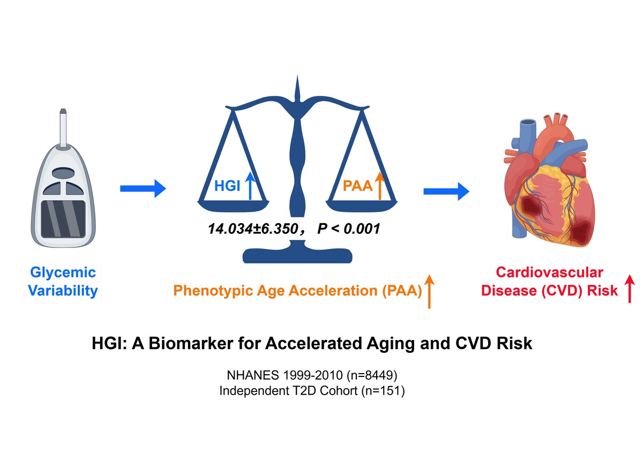

Hemoglobin glycation index as a screening tool for aging acceleration and cardiovascular disease: a population-based study
DOI: 10.5114/aoms/222389
Notes:
Introduction
Diabetes promotes aging and contributes to the progression of cardiovascular disease (CVD). Hemoglobin glycation index (HGI) serves as an indicator linking blood glucose to CVD, but the role of aging remains unclear. This study aimed to investigate the association between the HGI and CVD, and to evaluate whether accelerated aging mediates this relationship.
Material and methods
We conducted a cross-sectional analysis from the NHANES 1999-2010. HGI was used to assess interindividual glycemic variability, and phenotypic age acceleration (PAA) was employed to estimate biological aging. Relationships were studied using multivariable linear and logistic regression, LASSO regression, and mediation analysis. Patients with type 2 diabetes admitted to Xijing Hospital were enrolled to validate the efficacy of HGI.
Results
Analysis of 8,449 NHANES adults (median age 45 years; 48% male) revealed that 8.2% had CVD. Individuals with a positive HGI had a significantly higher risk of CVD, independent of age, sex, PAA, lipid levels, and renal function. A positive HGI was also positively associated with PAA (β= 14.034, P < 0.001). Mediation analysis showed PAA significantly mediated 23.8% (95% CI: 17.1%–29.0%, P < 0.001) of the relationship between HGI and CVD. In the validation cohort, positive HGI inversely correlated with cardiac function parameters, including left atrial strain during contraction phase (LASct) and left ventricular global longitudinal strain (LVGLS).
Conclusions
The HGI is a strong and clinically accessible biomarker for both accelerated biological aging and increased cardiovascular risk, especially in individuals with dysglycemia.

