Slide 1
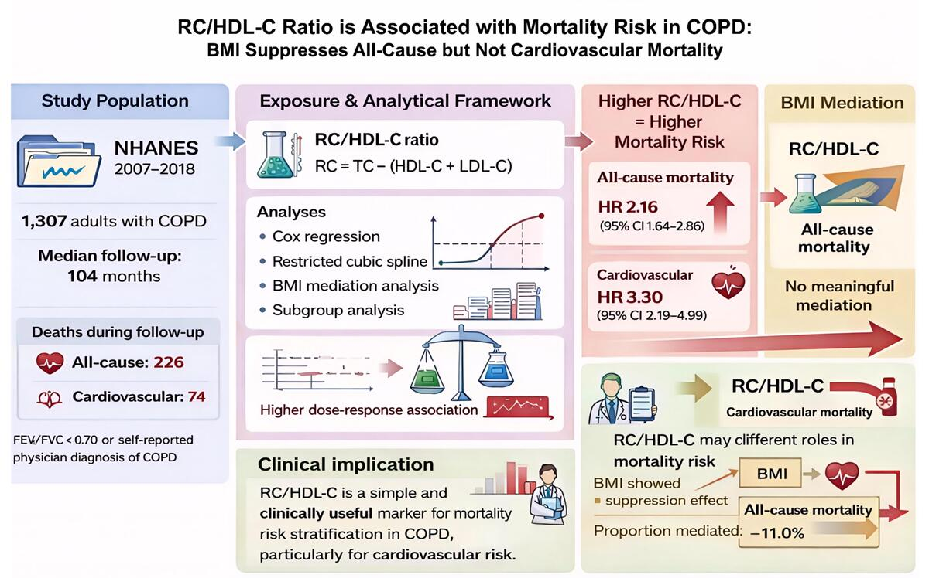

Association of the remnant cholesterol to high-density lipoprotein cholesterol ratio with mortality in chronic obstructive pulmonary disease: a mediation analysis of body mass index
DOI: 10.5114/aoms/222391
Notes:
Introduction
The remnant cholesterol to high-density lipoprotein cholesterol ratio (RC/HDL-C) reflects atherogenic lipid burden. We investigated its association with mortality in patients with chronic obstructive pulmonary disease (COPD) and the mediating role of body mass index (BMI).
Material and methods
This cross-sectional study included 1,307 COPD patients from NHANES 2007–2018. Multivariable Cox proportional hazards models were used to estimate hazard ratios (HRs) and 95% confidence intervals (CIs). Restricted cubic splines (RCS) were employed to assess dose-response relationships. Mediation analysis was conducted to quantify the extent to which BMI mediated the association between RC/HDL-C and mortality.
Results
During a median follow-up of 104 months, 226 all-cause and 74 cardiovascular deaths occurred. After adjusting for potential confounders, elevated RC/HDL-C was independently associated with higher risks of all-cause (HR = 2.16, 95% CI: 1.64–2.86) and cardiovascular mortality (HR = 3.30, 95% CI: 2.19–4.99). Mediation analysis indicated that BMI exerted a suppression effect on the association with all-cause mortality, masking 11.0% of the RC/HDL-C-associated risk. However, no significant mediating effect of BMI was observed for cardiovascular mortality. Stratified analyses indicated that these associations were more pronounced in patients younger than 65 years.
Conclusions
RC/HDL-C is independently associated with all-cause and cardiovascular mortality in COPD patients. While higher BMI partially suppresses the association between RC/HDL-C and all-cause mortality, no mediating effect is observed for cardiovascular mortality. The associations were more pronounced in younger patients, suggesting potential value for risk stratification in this subgroup.

