Slide 1
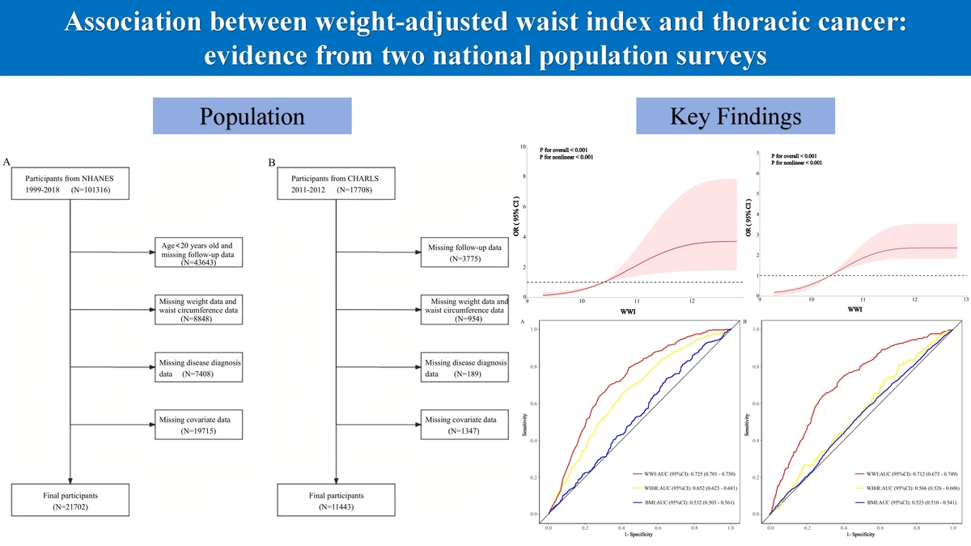

Association between weight-adjusted waist index and thoracic cancer: evidence from two national population surveys
DOI: 10.5114/aoms/222392
Notes:
Introduction
Obesity is closely associated with the risk of cancers. This study analyzed national population surveys from the United States and China to investigate the association between weight-adjusted waist index (WWI) and thoracic cancer.
Material and methods
Data from two national population surveys were used in the study. Logistic regression analysis was used to analyze the association between WWI and thoracic cancer. Restricted cubic spline (RCS) analysis was used to investigate a potential nonlinear relationship. The stability of this relationship across different subgroups was assessed through subgroup analysis. ROC curve analysis facilitated the evaluation of different obesity indicators in terms of their efficacy in predicting thoracic cancer.
Results
A relationship between thoracic cancer and WWI was identified. RCS analysis confirmed the nonlinear relationship between thoracic cancer and WWI (p for nonlinear < 0.001). The analysis of subgroups indicated that the association between thoracic cancer and WWI was broadly applicable across different populations, further confirming the robustness of the study findings. ROC analysis showed that WWI possessed satisfactory predictive capability for thoracic cancer.
Conclusions
The study showed that WWI was independently associated with thoracic cancer prevalence in both the United States and Chinese populations. Furthermore, the accuracy of WWI in predicting thoracic cancer risk surpasses that of conventional obesity indicators.

