Slide 1
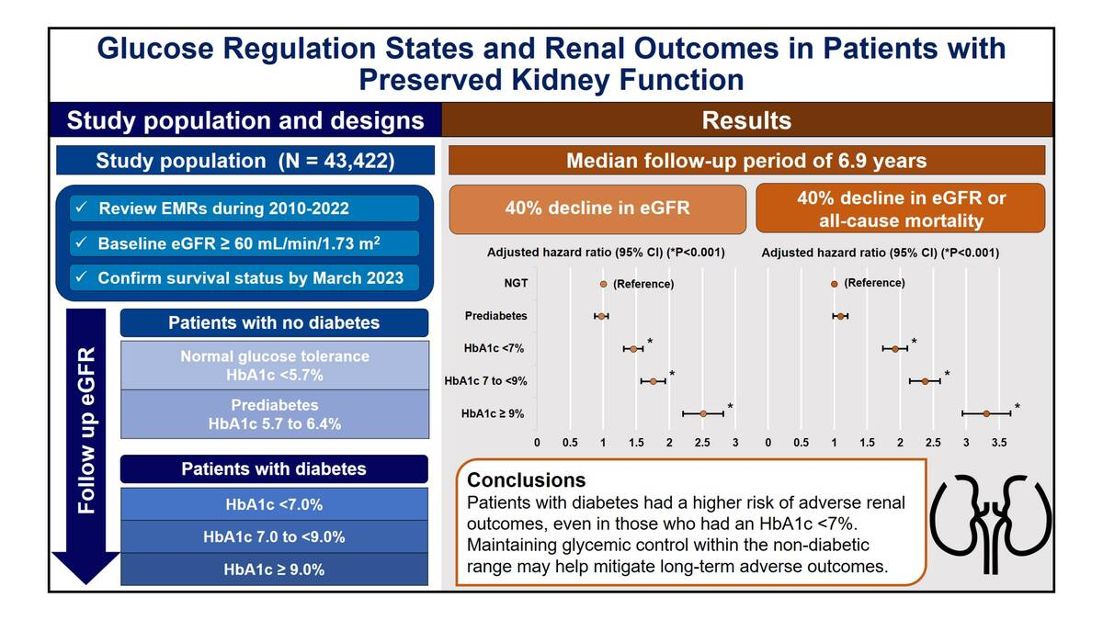

Glucose Regulation States and Renal Outcomes in Patients with Preserved Kidney Function
DOI: 10.5114/aoms/222687
Notes:
Introduction
We investigated the associations between glucose regulation states and the risks of adverse renal outcomes and all-cause mortality in a large outpatient population.
Material and methods
We retrospectively identified patients with a baseline estimated glomerular filtration rate (eGFR) ≥ 60 mL/min/1.73 m2 between 2010 and 2022. Patients were categorized into glucose regulation states according to their history of diabetes and glycated hemoglobin (HbA1c) levels. Data on each patient’s renal function were obtained from electronic medical records, and survival status was confirmed through March 2023. The outcomes of interest included adverse renal outcome (≥40% reduction of eGFR from baseline) and all-cause mortality.
Results
A total of 43,422 patients were analyzed. After a median follow-up of 6.9 years, patients with diabetes, stratified by HbA1c levels (<7.0%, 7.0 to <9%, and ≥ 9%), exhibited a significantly higher risk of adverse outcomes (adjusted HR 1.922, 2.376 and 3.306, respectively, all p<0.001) compared with those with normal glucose tolerance. In contrast, there was no significant difference in adverse outcomes between patients with prediabetes and those with normal glucose tolerance (adjusted HR 1.090, p=0.107).
Conclusions
Compared with normal glucose tolerance, patients with diabetes had a higher risk of adverse outcomes, even among those with an HbA1c <7%. Maintaining glycemic control within the non-diabetic range may help mitigate long-term adverse renal outcomes.

