Slide 1
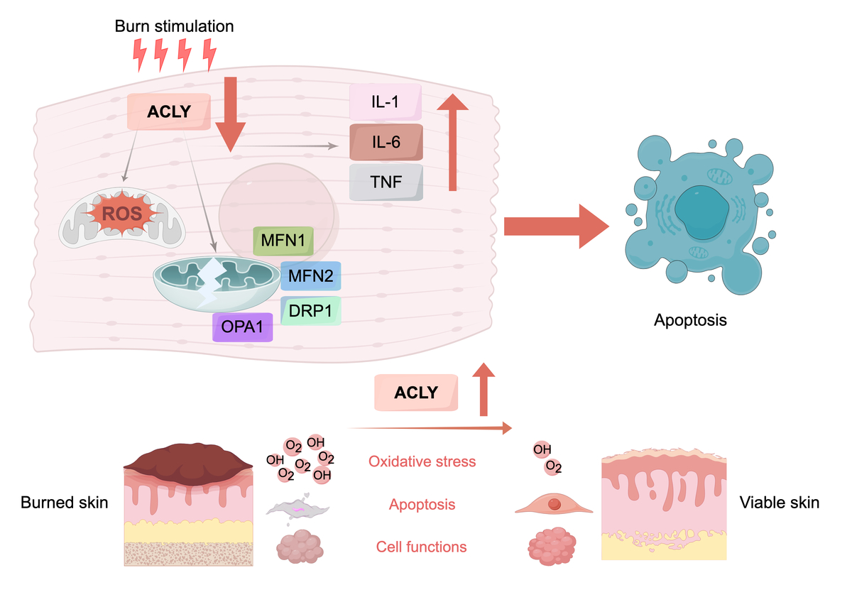

ACLY promotes epidermal regeneration and mitochondrial homeostasis in burn injury by reducing oxidative stress
DOI: 10.5114/aoms/222688
Notes:
Introduction
Burn injury causes cellular and metabolic dysfunction associated with mitochondrial damage, oxidative stress and impaired epidermal regeneration, delaying wound healing and raising the risk of chronic complications. As a key metabolic enzyme connecting the tricarboxylic acid cycle (TCA) cycle to lipid synthesis and epigenetic regulation, ATP citrate lyase (ACLY) maintains mitochondrial homeostasis and redox balance, while its role in thermal skin repair remains unclear.
Material and methods
RNA-seq analysis identified molecular changes in thermal injury, while polymerase chain reaction (PCR) and Western blot were used to validate ACLY expression in burn-injured skin tissue. To dissect ACLY function in wound repair, we performed in vivo AAV-mediated ACLY knockdown. A panel of assays was also conducted in in vivo and in vitro ACLY-overexpression models, including hematoxylin and eosin (HE), immunohistochemistry, 5-ethynyl-2-deoxyuridine (EdU) assay, Transwell migration and invasion, transferase dUTP nick end labelling (TUNEL) staining, acetyl coenzyme A (acetyl-CoA) and ATP quantification, malondialdehyde (MDA) and glutathione (GSH) detection, as well as JC-1 and 2,7-dichlorofluorescin diacetate (DCFH-DA) staining.
Results
ACLY expression was markedly downregulated in burn tissues with associated metabolic reprogramming. In vivo AAV-mediated ACLY knockdown markedly aggravated burn injury and impaired wound repair. In contrast, ACLY overexpression improved repair outcomes in both in vivo and in vitro thermal injury models. It relieved oxidative damage by lowering reactive oxygen species (ROS) and MDA, maintained mitochondrial integrity through modulating mitochondrial dynamics, attenuated inflammatory response and cellular apoptosis, and enhanced keratinocyte proliferation as well as migration, ultimately accelerating epidermal regeneration and wound healing.
Conclusions
ACLY plays an important role in regulating mitochondrial stability and epidermal repair following burns. These findings provide novel insights into metabolic mechanisms underlying tissue regeneration and suggest that ACLY may represent a potential therapeutic target for burn healing and regenerative medicine.

