Slide 1
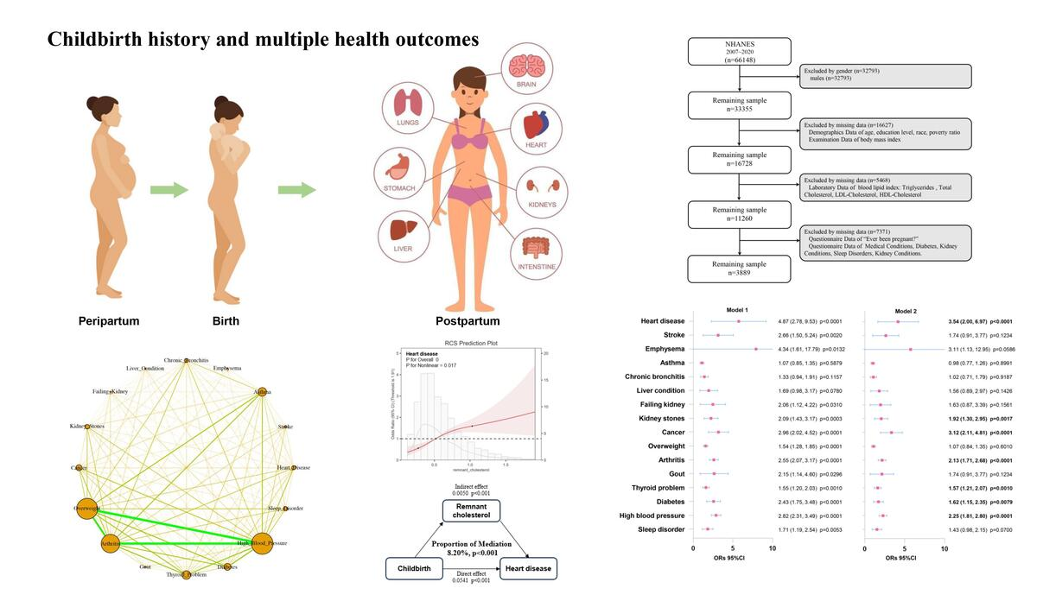

Association between childbirth history and multiple health outcomes
DOI: 10.5114/aoms/224184
Arch Med Sci 2026;22(4):1948-1960
Notes:
Introduction
The aim of the study was to investigate the association between childbirth experience and multiple health outcomes, and to discuss the role of blood lipids.
Material and methods
The cross-sectional study used data from the National Health and Nutrition Examination Survey (NHANES) from 2007 to 2020. Childbirth history (e.g., parity or number of live births) was obtained from questionnaire data. Blood lipid parameters included triglycerides, total cholesterol (TC), low-density lipoprotein cholesterol (LDL-C), and high-density lipoprotein cholesterol (HDL-C). Remnant cholesterol (RC) was calculated based on standard lipid equations.
Results
A total of 3889 participants were included in this study. Compared with women without childbirth history, the prevalence of several conditions was significantly higher among women with childbirth history, including high blood pressure (40.77% vs. 19.57%, p < 0.001), diabetes (13.15% vs. 5.86%, p < 0.001), heart disease (7.75% vs. 1.69%, p < 0.001) and arthritis (35.22% vs. 17.57%, p < 0.001). Individuals with two diseases were the most common (29.1%), and overweight–high blood pressure–arthritis was the most important comorbidity pattern. After multivariable adjustment, childbirth history was associated with higher odds of seven medical conditions (heart disease, cancer, kidney stones, arthritis, thyroid problem, diabetes, and high blood pressure). Odds ratios (OR) ranged from 1.57 to 3.54 and 95% confidence intervals (CIs) from 1.15 to 6.97 (p < 0.0001), depending on the outcome. In addition, the level of RC was significantly higher among women with these conditions (p < 0.001). A nonlinear (L-shaped) association between RC and several outcomes, including heart disease, arthritis, cancer, diabetes, and high blood pressure, was observed. Mediation analysis suggested that blood RC explained 8.2%, 10.6%, 6.84%, 17.7%, and 12.5% of the association between childbirth history and these outcomes.
Conclusions
Childbirth history was associated with multiple health outcomes in women, and RC may serve as a potential biomarker and partial mediator in these associations.

