Slide 1
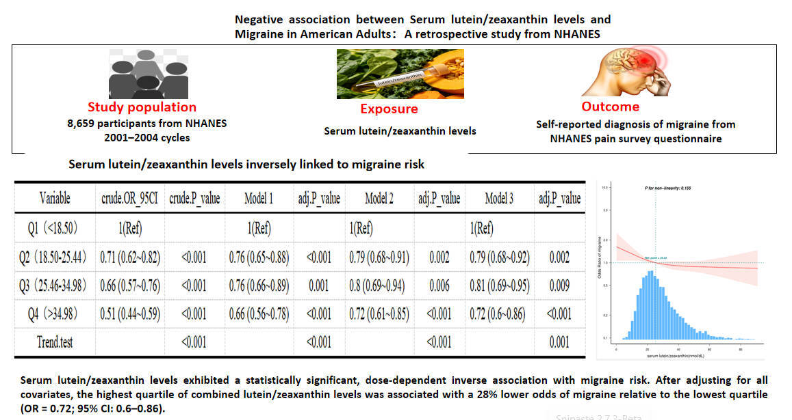

Negative association between serum lutein/zeaxanthin levels and migraine in American adults: a retrospective study from NHANES
DOI: 10.5114/aoms/224186
Arch Med Sci 2026;22(3):1893-1900
Notes:
Introduction
Material and methods
Results
Conclusions

