Slide 1
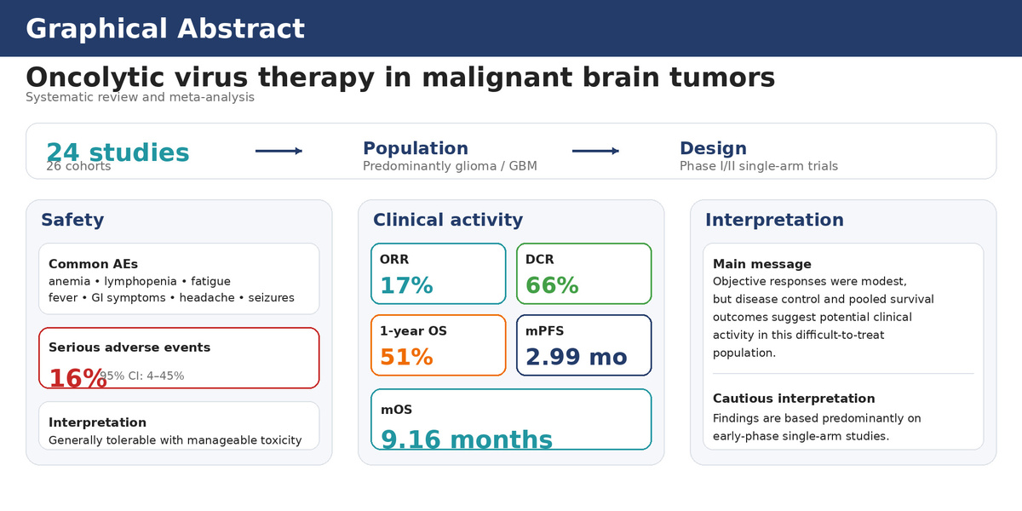

Safety and efficacy of oncolytic virus therapy in malignant brain tumours: a meta-analysis
DOI: 10.5114/aoms/224311
Notes:
Introduction
Oncolytic virus (OV) therapy has been investigated as a treatment for malignant brain tumours due to its ability to directly induce tumour cell lysis and stimulate antitumor immunity, especially in malignant gliomas. Nonetheless, clinical evidence is primarily derived from small, early-phase trials. We conducted a meta-analysis to consolidate the safety profile and clinical outcomes of OV therapy in patients with malignant brain tumours.
Methods
We searched PubMed, Embase, Web of Science, Cochrane Library, and ClinicalTrials.gov up to 31 December 2025. The outcomes assessed were adverse events (AEs), serious adverse events (SAEs), objective response rate (ORR), disease control rate (DCR), 1-year overall survival (OS) rate, median progression-free survival (mPFS), and median overall survival (mOS). Pooled estimates were calculated using random effects models.
Results
A total of 24 studies comprising 26 cohorts were included, with glioma as the predominant tumour type. All studies were phase I/II single-arm trials. Commonly reported AEs included anaemia, lymphopaenia, fatigue, fever, gastrointestinal symptoms, headache, and seizures. The pooled incidence of SAEs was 16% (95% CI: 4–45%). The pooled ORR was 17% (95% CI: 11–26%), and the DCR was 66% (95% CI: 47–81%). The 1-year OS rate was 51% (95% CI: 33–67%). mPFS and mOS were 2.99 months (95% CI: 1.90–4.08 months) and 9.16 months (95% CI: 7.37–10.96 months), respectively. Leave-one-out analysis confirmed the stability of these estimates.
Conclusions
OV therapy appears feasible and generally tolerable in patients with malignant brain tumours. Although evidence remains non-confirmatory, pooled outcomes provide descriptive evidence of potential clinical activity, reflected by disease control and survival.

