Slide 1
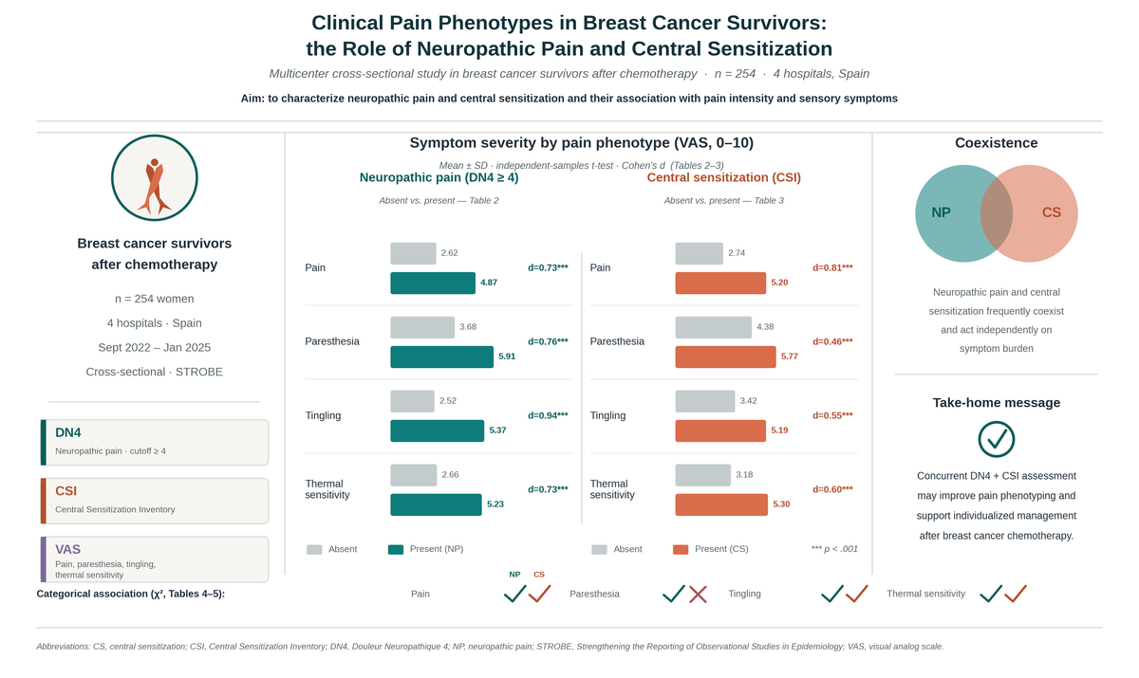

Clinical pain phenotypes in breast cancer survivors: the role of neuropathic pain and central sensitization
DOI: 10.5114/aoms/224764
Notes:
Introduction
Persistent pain is a common long-term sequela in breast cancer survivors treated with chemotherapy and may involve neuropathic pain and central sensitization (CS). However, few studies have examined these mechanisms together and their association with specific sensory symptoms.
Material and methods
A multicenter cross-sectional study was conducted in four Spanish hospitals between September 2022 and January 2025. A total of 254 women with surgically treated breast cancer who had completed chemotherapy were included. Neuropathic pain was assessed using the Spanish version of the Douleur Neuropathique 4 (DN4), CS using the Central Sensitization Inventory (CSI), and pain intensity and sensory symptoms (paresthesia, tingling, and thermal sensitivity) using visual analog scales. Between-group comparisons according to the presence of neuropathic pain and central sensitization, as well as analyses of their independent and combined effects on pain intensity and sensory symptoms, were performed.
Results
Participants reported moderate pain intensity, with clinically relevant neuropathic pain features and CS. Patients with neuropathic pain (DN4 ≥ 4) showed significantly higher pain intensity and greater severity of all sensory symptoms (all p < 0.001). Similarly, participants with CS reported higher pain intensity and greater severity of tingling and thermal sensitivity. Neuropathic pain and CS were independently associated with increased symptom burden and frequently coexisted.
Conclusions
Neuropathic pain and CS are common and overlapping components of persistent pain in breast cancer survivors treated with chemotherapy and are associated with greater pain intensity and sensory symptom severity. Concurrent assessment of both mechanisms may improve the clinical characterization and management of post-chemotherapy pain.

