Slide 1
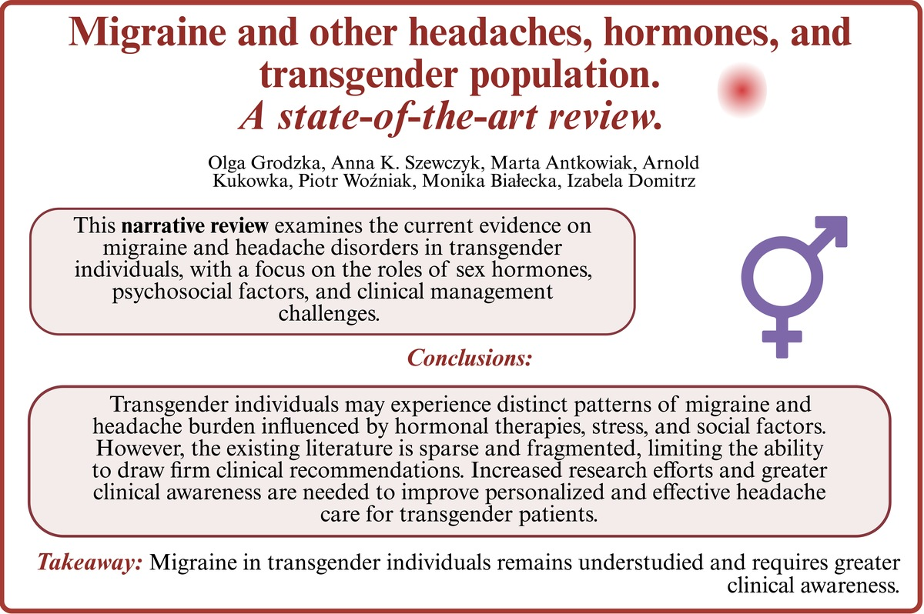

Headaches, hormones, and transgender individuals: current evidence and knowledge gaps
DOI: 10.5114/aoms/224765
Notes:
Migraine is a prevalent primary headache disorder affecting 14–17% of the global population and is strongly influenced by sex hormones. However, its characteristics in transgender individuals remain poorly understood and insufficiently studied. This review synthesizes evidence from 126 publications across neurology, otorhinolaryngology, pharmacology, and psychiatry to explore potential relationships between migraine and transgender health. Findings suggest that sex-related differences in migraine extend beyond epidemiology to clinical presentation, severity, and management, and may manifest uniquely in transgender patients. Factors such as gender-affirming hormone therapy, psychosocial stress, internal conflict, minority stress, and societal stigma may contribute to an increased headache burden. Additionally, barriers to healthcare access and limited provider knowledge may further complicate diagnosis and treatment. Despite these insights, data remain limited and fragmented. Greater awareness, interdisciplinary collaboration, and further research are needed to improve understanding and to develop more personalized, inclusive, and effective approaches to migraine management in transgender populations.

