Slide 1
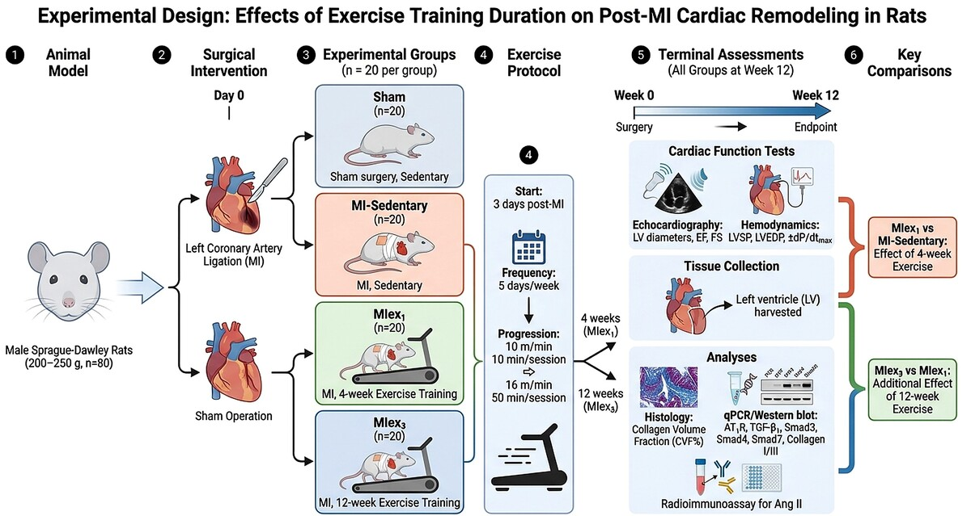

Association of AT1R mediated TGF β1/Smad axis down regulation with anti fibrotic and functional benefits of extended exercise after myocardial infarction
DOI: 10.5114/aoms/224767
Notes:
Introduction
Exercise training (ET) has cardioprotective effects after myocardial infarction (MI), but the associated molecular pathways remain incompletely defined. The novel aspect of this work is the comparison of short-term and extended post-MI ET while examining the angiotensin II type 1 receptor (AT1R)/TGF-β1/Smad axis as an associated anti-fibrotic pathway.
Material and methods
Sprague-Dawley rats were assigned to four groups: sham control, MI-sedentary, MI with 4-week ET (MIex1), and MI with 12-week ET (MIex3). ET began three days after coronary artery ligation. After 12 weeks, echocardiography and haemodynamic measurements were performed, and left ventricular (LV) tissue was collected for histological and molecular analyses.
Results
Compared with MI-sedentary rats, MIex1 rats showed increased LV systolic pressure, ±dP/dtmax, ejection fraction, and fractional shortening, along with decreased LV end-diastolic pressure and LV diameters. Twelve-week ET further enhanced functional outcomes. Both ET groups reduced collagen volume fraction and collagen I/III expression. ET was also associated with lower cardiac Ang II, AT1R, TGF-β1, and phosphorylated Smad2/3, with stronger effects after 12 weeks of ET.
Conclusions
Exercise reduces myocardial fibrosis following MI and preserves cardiac function, an effect that may be amplified by extended exercise training. Downregulation of AT1R-mediated TGF-β1/Smad signalling may be associated with these cardioprotective effects.

