Slide 1
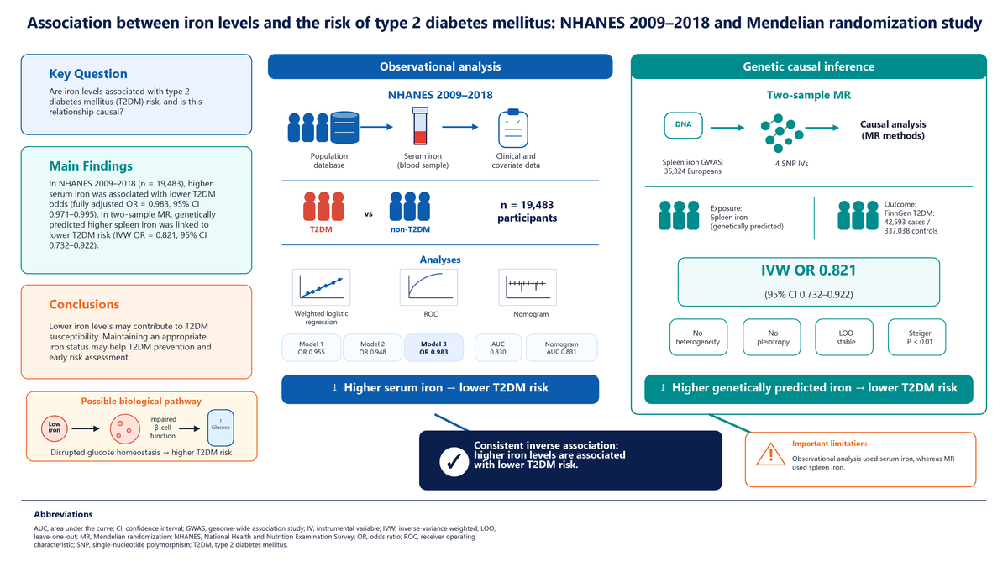

Association between iron levels and the risk of type 2 diabetes mellitus: NHANES 2009−2018 and Mendelian randomization study
DOI: 10.5114/aoms/224768
Notes:
Introduction
The association between serum iron levels and type 2 diabetes mellitus (T2DM) remains unclear.
Material and methods
In total, 19,483 participants from the National Health and Nutrition Examination Survey (NHANES) 2009–2018 were included in this study. The weighted t-test and chi-squared test were used to compare differences in iron levels and covariates between individuals with and without T2DM. Subsequently, weighted multivariate logistic regression models were constructed to assess the association between iron levels and T2DM risk. Furthermore, Mendelian randomization (MR) analysis was conducted to evaluate the causal effect of iron levels on T2DM. Sensitivity analysis and Steiger’s test were employed to validate the dependability and effectiveness of the MR findings.
Results
Weighted multivariate logistic regression analyses revealed a statistically significant inverse association between iron levels and T2DM risk, with odds ratios of 0.955, 0.948, and 0.983 in models 1, 2, and 3, respectively. Receiver operating characteristic curve analysis implied that iron levels accurately identified patients with T2DM. MR analysis demonstrated a marked causal impact of iron levels on T2DM risk, and iron levels represented a protective factor to some extent. Sensitivity analysis confirmed the robustness of the MR findings, and Steiger’s test confirmed the plausibility and validity of the causal effect direction of iron levels on T2DM.
Conclusions
This study supported a negative correlation between iron levels and T2DM risk, which holds potential clinical significance for T2DM prevention and early risk assessment.

