Slide 1
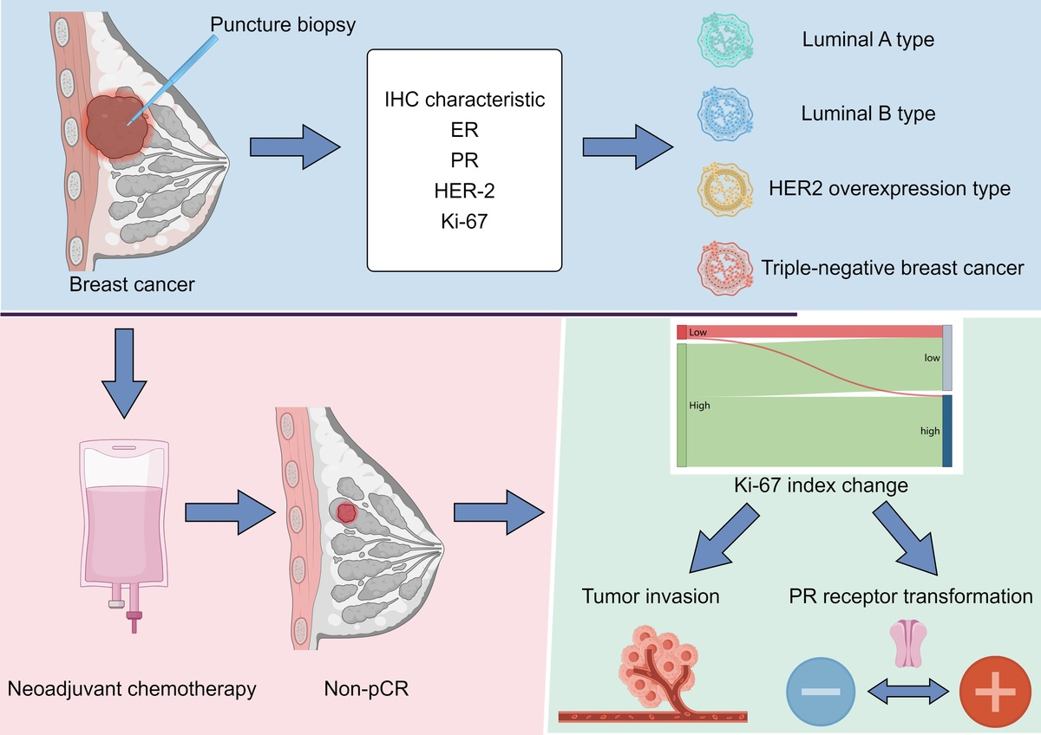

Ki-67 index changes and their association with PR status changes and tumor invasion: a real-world study of patients with non-pCR breast cancer after neoadjuvant chemotherapy
DOI: 10.5114/aoms/224769
Notes:
Introduction
Neoadjuvant chemotherapy (NAC) represents a crucial treatment strategy designed to reduce tumor size and facilitate surgical intervention. In patients who do not achieve a pathological complete response (pCR) following NAC, the alteration of receptor status has been observed, but their clinical implications remain unclear. The aim of this study was to investigate the dynamic changes in immunohistochemical (IHC) expression and their association with clinicopathological features in non-pCR breast cancer patients.
Material and methods
A total of 88 non-pCR breast cancer patients diagnosed by core needle biopsy at Baoji Central Hospital between January 1, 2024, and June 1, 2025, were included. Estrogen receptor (ER), progesterone receptor (PR), human epidermal growth factor receptor 2 (HER2), and the proliferation marker Ki-67 were assessed in biopsy and radical resection tissues after NAC.
Results
A total of 147 breast cancer patients were retrieved, and 88 patients were included in the study. Among them, there were 3 cases of luminal A type (3.42%), 71 cases of luminal B type (80.68%), 7 cases of HER2-enriched type (7.95%) and 7 cases of triple-negative breast cancer (TNBC) type (7.95%). The overall change rate of ER, PR, HER2, Ki-67 was 6.82%, 15.91%, 22.73% and 40.91%, respectively. Changes in the Ki-67 index change were significantly associated with tumor invasion and PR receptor status changes (p < 0.001), but not with ER and HER2 changes (p = 0.267, p = 0.620).
Conclusions
Ki-67 exhibited the highest alteration rate following NAC in non-pCR breast cancer patients, and its change was significantly associated with aggressive tumor features and PR conversion, suggesting a potential association with tumor biological characteristics.

