Slide 1
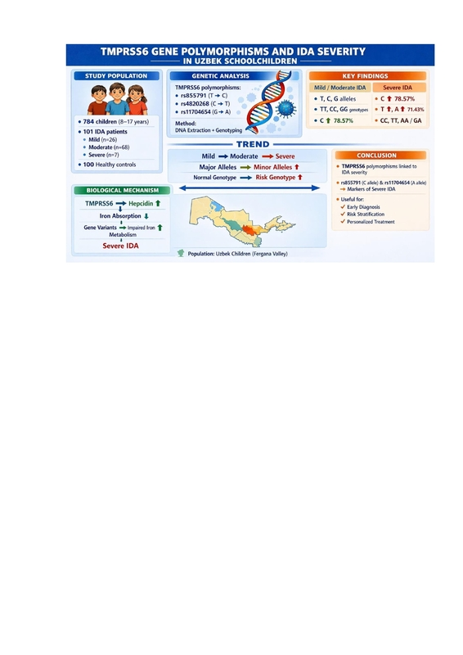

Association of <i>TMPRSS6</i> gene polymorphisms with severity of iron deficiency anemia in Uzbek schoolchildren: a molecular case-control study
DOI: 10.5114/aoms/224771
Arch Med Sci 2026;22(3):1914-1917
Notes:
Introduction
Material and methods
Results
Conclusions

