Slide 1
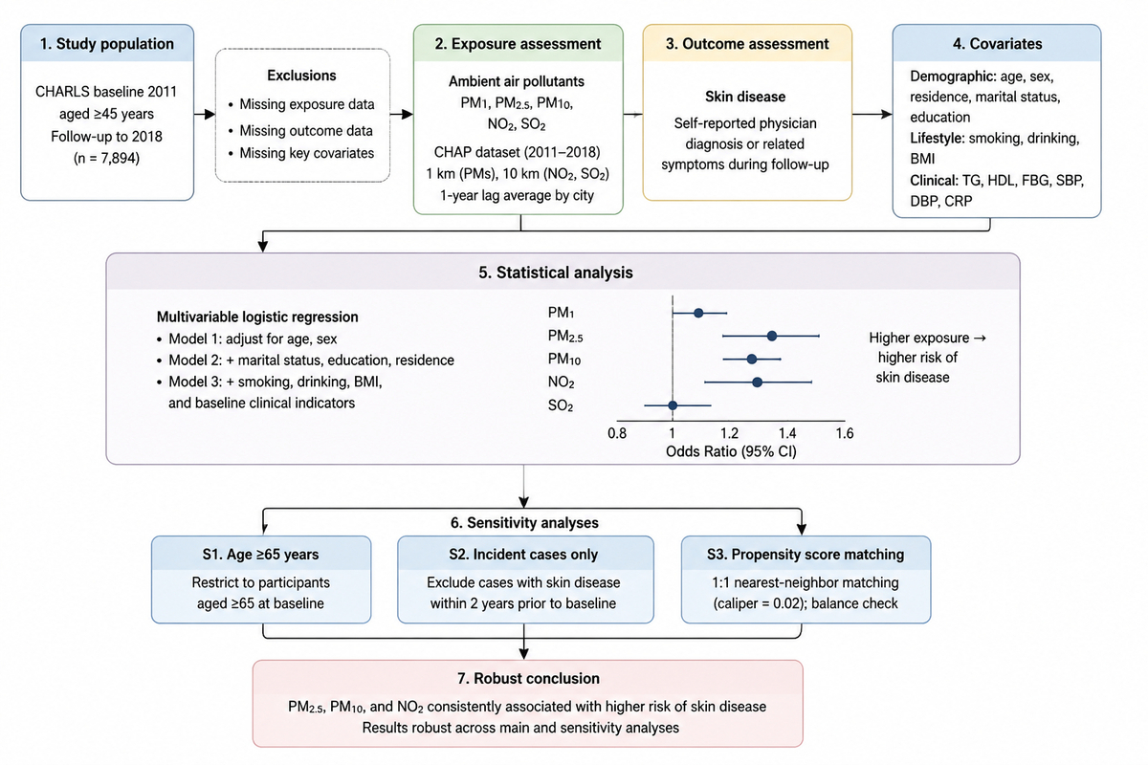

Association between ambient air pollution and skin health in middle-aged and older adults: the China Health and Retirement Longitudinal Study
DOI: 10.5114/aoms/224873
Notes:
Introduction
Long-term exposure to ambient air pollution is a significant public health concern, yet its specific association with skin diseases in the Chinese middle-aged and older population remains insufficiently characterized, with limited evidence on the role of individual pollutants.
Material and methods
We analyzed prospective data from the China Health and Retirement Longitudinal Study (CHARLS), a nationally representative cohort. Participants aged ≥ 45 years from the 2011 baseline survey were followed through 2018. Annual average concentrations of PM<sub>2.5</sub>, PM<sub>10</sub>, NO<sub>2</sub>, SO<sub>2</sub>, and PM1 at participants’ community residences were assessed using satellite-based models with 1-km resolution. Skin disease was defined by a self-reported physician diagnosis or related symptoms. Multivariable logistic regression models were used to estimate odds ratios (ORs), adjusting for demographic, socioeconomic, lifestyle, and health-related covariates. Sensitivity analyses included age-restricted (≥65 years) and incident-case cohorts, and propensity score matching.
Results
Among 7,894 participants, long-term exposure to higher levels of PM<sub>2.5</sub> (fully adjusted OR = 1.25, 95% CI: 1.13–1.38), PM<sub>10</sub> (OR = 1.18, 95% CI: 1.04–1.32), and NO<sub>2</sub> (OR = 1.15, 95% CI: 1.02–1.29) was significantly associated with higher odds of skin disease. Associations for SO<sub>2</sub> and PM1 were not statistically significant. Results remained consistent across all sensitivity analyses, supporting the robustness of the findings.
Conclusions
This national cohort study provides evidence that long-term exposure to PM<sub>2.5</sub>, PM<sub>10</sub>, and NO<sub>2</sub> is associated with higher odds of skin diseases among Chinese middle-aged and older adults. These findings suggest that air pollution control may represent a potential intervention target for reducing the burden of skin disease in aging populations.

