Slide 1
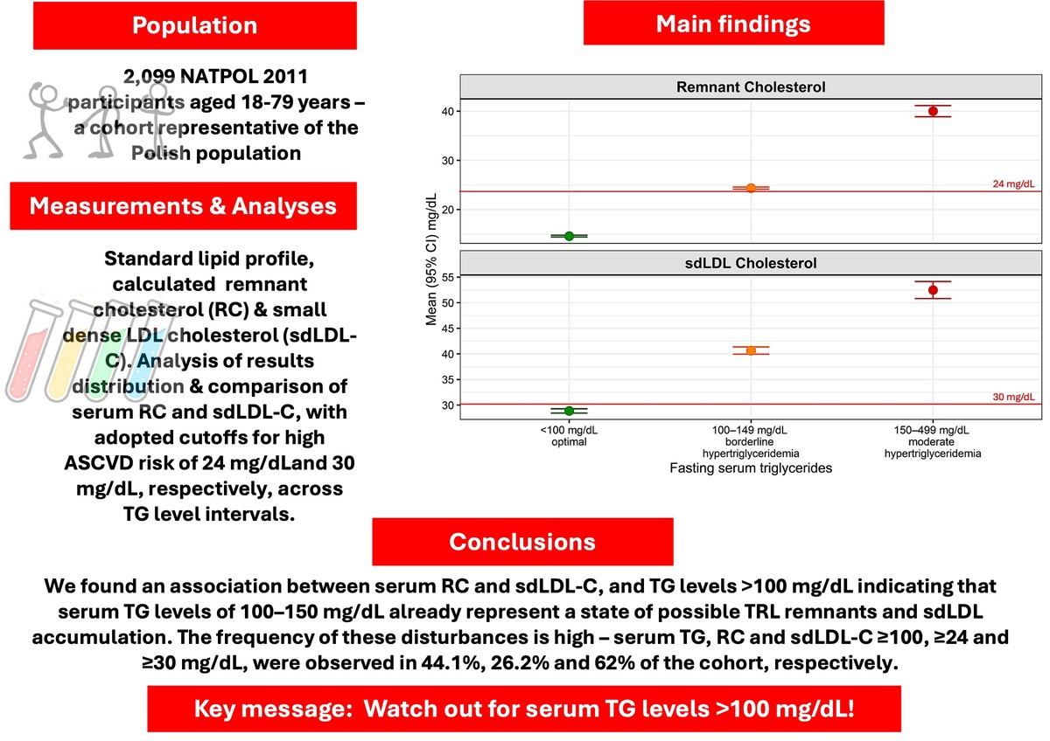

Serum triglycerides, remnant cholesterol and small dense low-density lipoprotein cholesterol levels – lessons from the NATPOL 2011 survey
DOI: 10.5114/aoms/224964
Notes:
Introduction
The role of triglyceride-rich lipoproteins in atherogenesis is insufficiently recognized and often underestimated. WE aimed to evaluate the distribution of serum triglyceride (TG), remnant cholesterol (RC), and small dense LDL cholesterol (sdLDL-C) levels and their interrelationships in participants of the NATPOL 2011 survey.
Material and methods
In approximately 2,000 NATPOL participants, serum TG was measured, and serum RC and sdLDL-C were calculated and compared between women and men, across age groups, and in relation to overweight/obesity and plasma glucose. RC/sdLDL-C levels were also compared in the serum TG intervals: <100, 100–149 and 150–499 mg/dL, and their percentile distribution was analyzed.
Results
Serum TG, RC and sdLDL-C were higher in overweight / obese participants and in those with prediabetes. In subjects with serum TG <100, 100–149 and 150–499 mg/dL, RC and sdLDL-C levels were successively higher, with values adopted as cut-offs for high ASCVD risk observed in both intervals >100 mg/dL. Participants with serum RC and sdLDL-C above these cutoffs had higher TG. Serum TG of 100 mg/dL and 150 mg/dL were the 55.9th and 88.2nd percentile, respectively, serum RC of 24 mg/dL was the 73.8th percentile, and serum sdLDL-C of 30 mg/dL (adopted cut-offs) was the 38th percentile of the distribution results.
Conclusions
We found an association between serum RC and sdLDL-C, and TG levels >100 mg/dL indicating that serum TG levels of 100–150 mg/dL already represent a state of possible TRL remnants and sdLDL accumulation. Calculated serum RC/sdLDL-C may be considered a useful supplement to the lipid profile.

