Slide 1
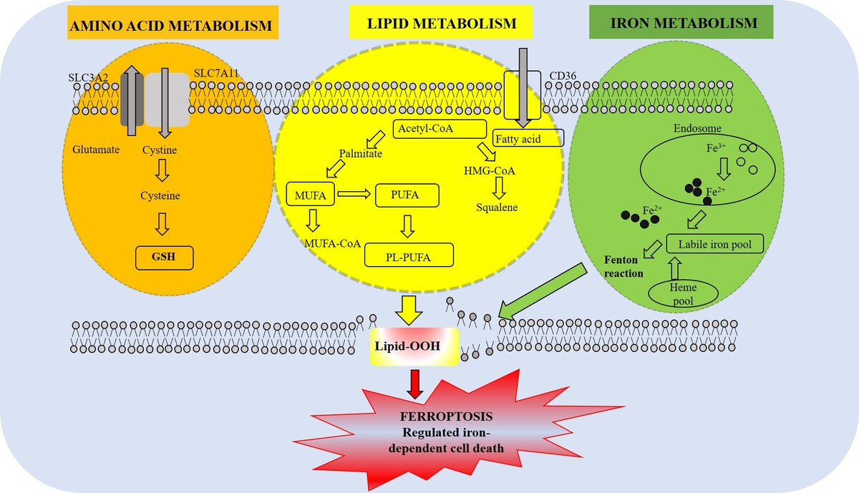

Metabolic alterations and redox homeostasis in ferroptosis: emerging mechanisms and therapeutic implications
DOI: 10.5114/aoms/225096
Arch Med Sci 2026;22(4):2231-2249
Notes:
Ferroptosis is a programmed cell death characterized by excessive, iron-dependent accumulation of membrane lipid peroxides due to insufficient glutathione-dependent antioxidant defense. It is influenced by the metabolism of amino acids, lipids, and iron, and occurs in conditions of decreased glutathione peroxidase 4 (GPX4) activity. The increased polyunsaturated fatty acid (PUFA) content in membrane phospholipids is associated with cellular hypersusceptibility to ferroptosis. In contrast, incorporation of monounsaturated fatty acids may protect cells against ferroptotic cell death. Cellular sensitivity to ferroptosis is additionally influenced by glutamine catabolism and the xc–system-mediated import of cystine, which modulate glutathione production, and by elevated iron levels, which lead to the buildup of reactive oxygen species (ROS) that attack membrane-localized PUFAs. This review focuses on recent findings of perturbed metabolic processes in cancer that create a high iron demand and an altered lipid composition, thereby predisposing cells to ferroptosis. We analyze the therapeutic potential of pharmacological agents that can selectively trigger ferroptosis in tumor cells.

