Slide 1
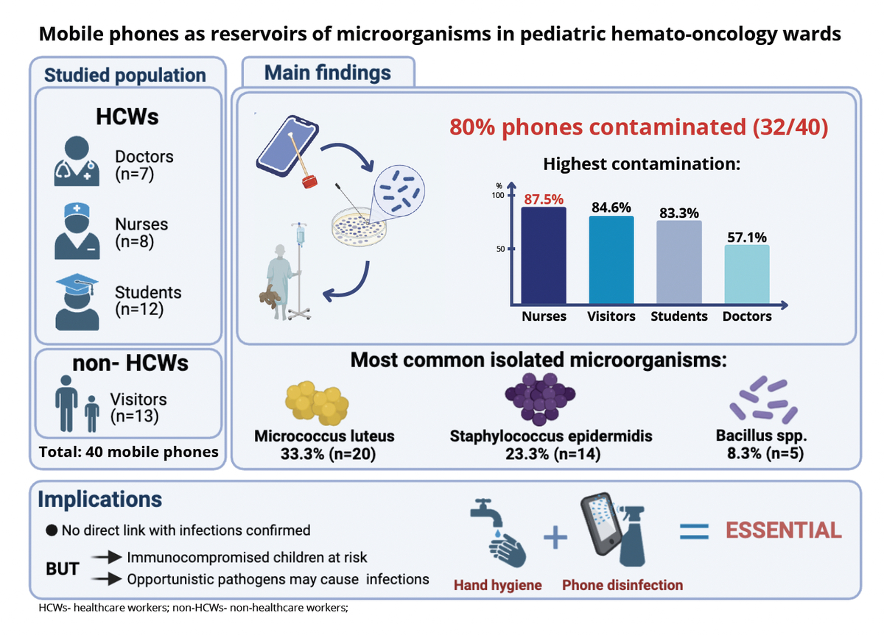

Assessment of microbial contamination of mobile phones among medical staff, students, and visitors in a pediatric hematology-oncology ward and its relationship with infections among pediatric patients
DOI: 10.5114/aoms/225097
Arch Med Sci 2026;22(4):1970-1977
Notes:
Introduction
Healthcare-associated infections (HAIs) remain a significant threat to patient safety. The aim of this study was to evaluate the frequency and extent of microbial contamination of cell phones (CPs) used by medical staff, medical students, and visitors to pediatric patients with hematological and oncological diseases and immune disorders, as well as their potential contribution to microbial dissemination in the hospital environment.
Material and methods
The study was conducted at the Department of Pediatric Hematology, Oncology, and Transplantation at the University Children’s Hospital in Lublin between May and July 2025. Samples were collected by swabbing the surfaces of cell phones. The samples were analyzed in an outsourced laboratory in accordance with standard procedures. Additionally, patients’ medical records were reviewed for signs of infection.
Results
Forty active CP users were included in the study, including visitors (n = 13), students (n = 12), nurses (n = 8), and doctors (n = 7). Contamination was detected in 32/40 (80%) CP samples. A total of 61 strains were isolated: 60 bacterial strains and 1 mold isolate. The most prevalent species were Micrococcus luteus (33.3%; n = 20) and Staphylococcus epidermidis (23.3%; n = 14). The highest proportion of contaminated CPs was observed among nurses (87.5%). Symptoms of infection were observed in 7 patients; however, no correlation was found between the microorganisms isolated from CPs and the etiological agents identified in patients with infections.
Conclusions
The results indicate that CPs used by medical staff are frequently contaminated with bacteria. This suggests that, in addition to their communicative function, they may serve as potential reservoirs of microorganisms and therefore warrant attention in infection prevention strategies.

