Slide 1
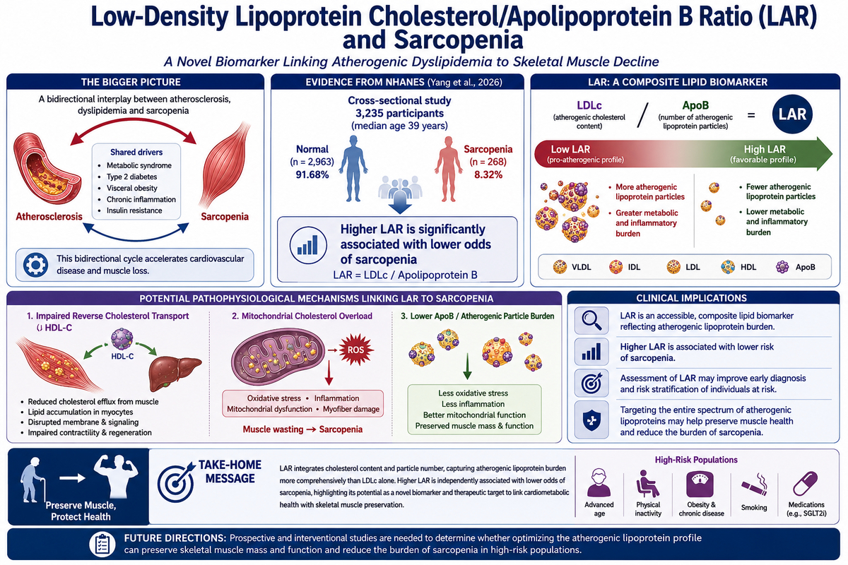

Beyond traditional lipid markers: low-density lipoprotein cholesterol with apolipoprotein B ratio – a novel biomarker for sarcopenia?
DOI: 10.5114/aoms/225162
Arch Med Sci 2026;22(3):1335-1337

