Slide 1
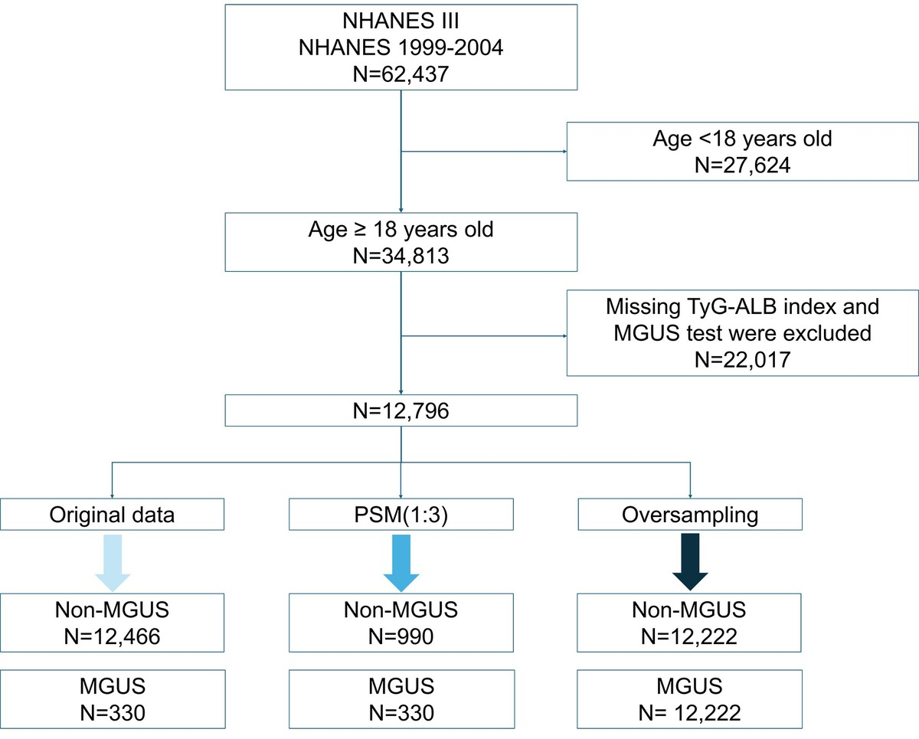

Higher triglyceride–glucose–albumin index is inversely associated with monoclonal gammopathy of undetermined significance in U.S. adults using NHANES data
DOI: 10.5114/aoms/225240
Notes:
Introduction
Monoclonal gammopathy of undetermined significance (MGUS) is a premalignant plasma cell disorder with increasing recognition of its metabolic and inflammatory determinants. The triglyceride–glucose–albumin (TyG-ALB) index, a composite marker integrating insulin resistance and nutritional status, has been linked to cardiometabolic and inflammatory conditions; however, its association with MGUS remains unclear.
Material and methods
This cross-sectional study included 12,796 adults from the National Health and Nutrition Examination Survey (NHANES) III (1988–1994) and continuous NHANES cycles (1999–2004). The TyG-ALB index was calculated as ln [TG (mg/dl) × fasting blood glucose (mg/dl)/2] × albumin (g/dl). MGUS was assessed using serum protein electrophoresis, immunofixation, and free light chain assays. Survey-weighted logistic regression models were applied to evaluate the association between TyG-ALB and MGUS.
Results
Among the 12,796 participants, 330 were diagnosed with MGUS. Higher TyG-ALB levels were associated with lower odds of MGUS. In fully adjusted models, participants in the highest tertile of TyG-ALB had lower odds of MGUS compared with those in the lowest tertile [odds ratio (OR) = 0.68, 95% confidence interval (CI): 0.50–0.94]. When analysed as a continuous variable, each one-unit increase in TyG-ALB was associated with 5% lower odds of MGUS (OR = 0.95, 95% CI: 0.92–0.98). Restricted cubic spline analyses revealed a nonlinear inverse association, with an inflection point at a TyG-ALB value of 36.0. Although this inverse association appears counterintuitive because metabolic dysfunction is generally expected to increase MGUS risk, it may be partly explained by the contribution of serum albumin, which reflects better nutritional status and lower systemic inflammation.
Conclusions
In this cross-sectional NHANES analysis, higher TyG-ALB was associated with lower odds of prevalent MGUS; however, temporality and causality cannot be inferred. These findings should be interpreted as hypothesis-generating rather than confirmatory. Independent prospective cohorts are needed to validate the association, establish temporality, and clarify the underlying mechanisms.

