Slide 1
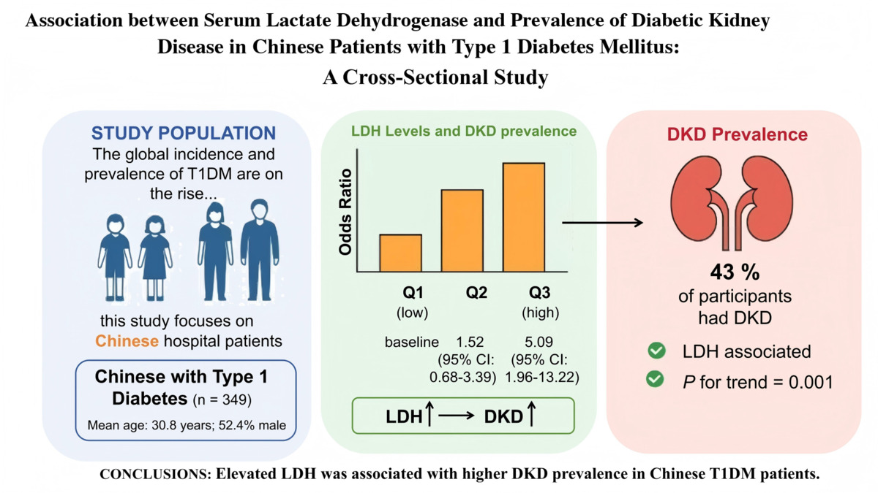

Association between serum lactate dehydrogenase and prevalence of diabetic kidney disease in Chinese patients with type 1 diabetes mellitus: a cross-sectional study
DOI: 10.5114/aoms/225401
Arch Med Sci 2026;22(4):2479-2485
Notes:
Introduction
Material and methods
Results
Conclusions

