Slide 1
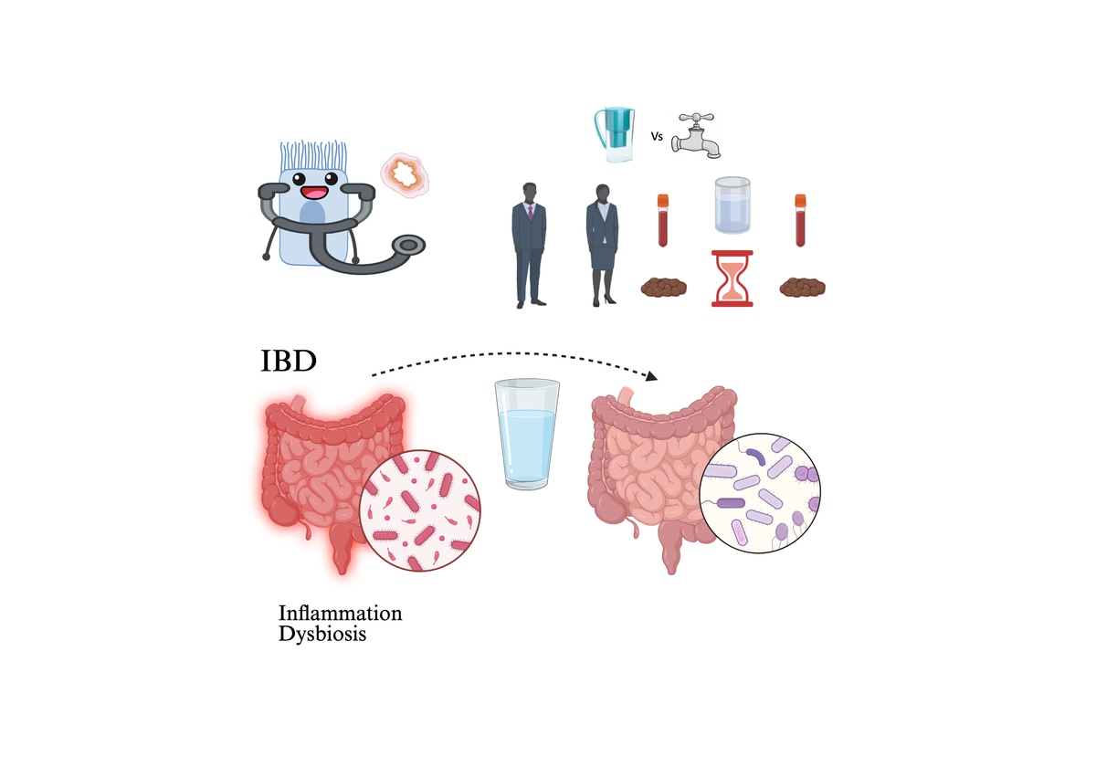

Alkalinised filtered water induces changes in the gut microbiome in inflammatory bowel disease
DOI: 10.5114/aoms/225476
Notes:
Introduction
This study evaluated the effects of filtered, alkalinised water on inflammation and intestinal dysbiosis in individuals with inflammatory bowel disease (IBD).
Material and methods
We conducted a three-month, two-arm, randomised intervention study involving 46 patients with IBD in remission. Fifty-two volunteers were recruited and divided into two groups (n = 26): the control group consumed water from a mock device, and the test group consumed alkalinised filtered water. Forty-six (21/25) volunteers completed the study. Blood and stool samples were collected before and after the intervention. We assessed antioxidant capacity and circulating cytokine levels from plasma. Gene expression levels of inflammatory mediators were determined using mRNA from peripheral blood mononuclear cells (PBMCs). The microbial composition of faecal samples was characterised by qPCR analysis using primers targeting 16S rRNA genes.
Results
Consumption of alkalinised filtered water significantly reduced IL1B gene expression in PBMCs. Furthermore, subjects drinking alkalinised filtered water exhibited a consistent, albeit not statistically significant, decrease in circulating IL-1b and significantly lower levels of IL-4 than controls. Microbiome analysis revealed that the levels of the Bacteroides fragilis Group were significantly reduced in subjects consuming tap water but not in those consuming filtered water.
Conclusions
These changes suggest that consuming alkalinised water for three months leads to an improved inflammatory status compared with consuming tap water.

