Slide 1
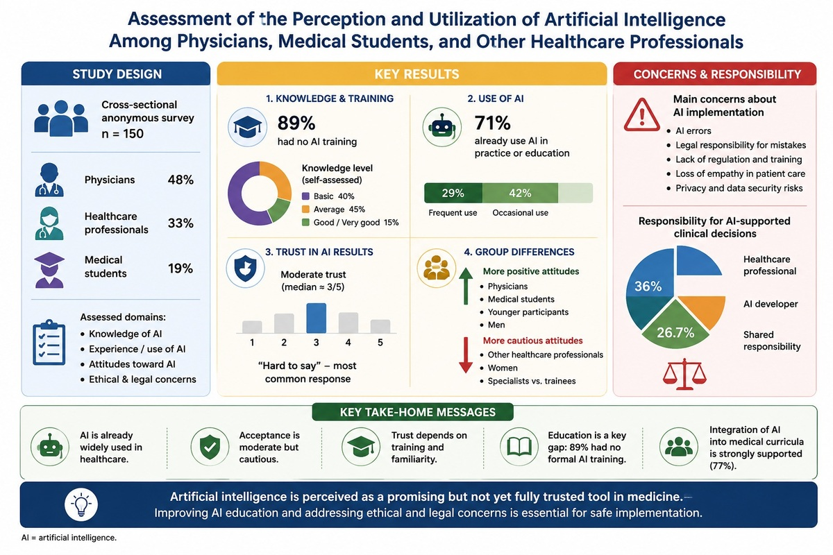

Assessment of the perception and use of artificial intelligence among physicians, medical students, and other healthcare professionals
DOI: 10.5114/aoms/225477
Arch Med Sci 2026;22(4):2457-2460
Notes:
Introduction
Material and methods
Results
Conclusions

