Slide 1
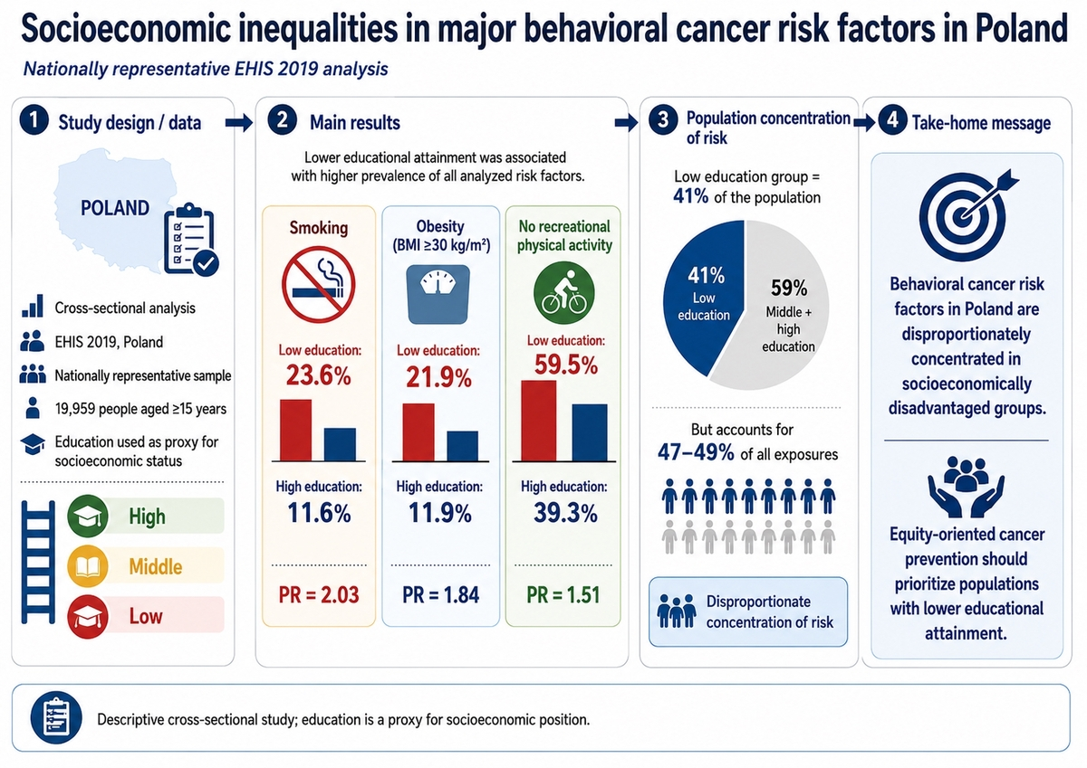

Socioeconomic inequalities in major behavioral cancer risk factors in Poland: evidence from a nationally representative health survey
DOI: 10.5114/aoms/225664
Notes:
Introduction
Cancer remains a major public health burden in Poland, with a substantial proportion of cases attributable to modifiable behavioral risk factors such as smoking, obesity, and physical inactivity. These factors are socially patterned, contributing to health inequalities across socioeconomic groups. The study aimed to quantify socioeconomic gradients in key behavioral cancer risk factors in Poland.
Material and methods
A cross-sectional analysis was conducted using data from the Polish wave of the European Health Interview Survey (EHIS) 2019, covering a nationally representative sample of individuals aged ≥ 15 years. Educational attainment was used as an indicator of socioeconomic status (SES; high, middle, low). Prevalence of smoking, obesity (body mass index ≥ 30 kg/m²), and lack of recreational physical activity were estimated across educational groups. Socioeconomic gradients were assessed using prevalence ratios (PRs), and the estimated number of individuals exposed to each risk factor was calculated using national population estimates.
Results
Clear socioeconomic gradients were observed for all analyzed risk factors. Individuals with low education had higher prevalence of smoking (23.6% vs. 11.6%, PR = 2.03), obesity (21.9% vs. 11.9%; PR = 1.84), and physical inactivity (59.5% vs. 39.3%; PR = 1.51) compared to those with high education. The low-education group (41% of the population) accounted for ~47–49% of all exposures, indicating a disproportionate concentration of behavioral cancer risk. Reducing these inequalities could substantially decrease the population burden of risk factors.
Conclusions
Behavioral cancer risk factors in Poland are unequally distributed and disproportionately concentrated among socioeconomically disadvantaged groups. Addressing these inequalities through targeted, equity-oriented prevention strategies may help reduce the future cancer burden.

