Slide 1
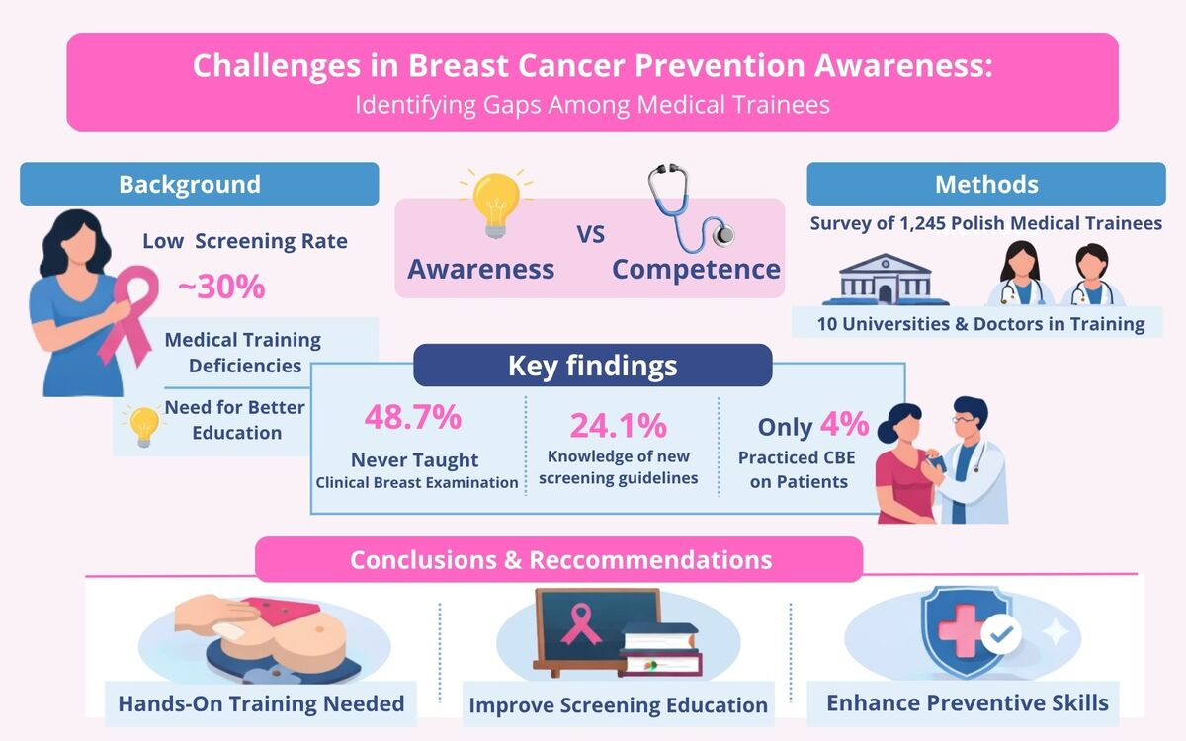

Challenges in breast cancer prevention knowledge and training: identifying gaps among medical trainees
DOI: 10.5114/aoms/225927
Notes:
Introduction
Breast cancer is the most common malignancy among women in Poland, yet participation in the national mammography screening programme remains low (approximately 30%). Medical trainees play a crucial role in promoting prevention, but their preparation in this area is insufficiently explored.
Material and methods
A cross-sectional online survey was conducted among students from 10 Polish medical universities and doctors-in-training (from November 2024 to February 2025). The questionnaire assessed knowledge of screening guidelines, exposure to curricular training, and self-reported competence in clinical breast examination (CBE). Descriptive statistics and  tests were used to analyse associations between categorical variables.
Results
A total of 1,245 participants were included. Nearly half (48.7%) had never been taught CBE, and only 4% had practised with patients. While most respondents recognised mammography as an effective screening tool (96.4%), only 24.1% correctly identified both the screening interval and eligible age group. Attendance at curricular classes was significantly associated with better knowledge, higher confidence in performing CBE independently (p < 0.001), and greater comfort discussing breast self-examination with patients (85% vs. 76%, p < 0.001).
Conclusions
This nationwide study highlights major gaps in breast cancer prevention education among Polish medical trainees. Although general awareness of mammography is high, understanding of programme details and practical CBE skills remains limited. Structured, competency-based curricula incorporating hands-on and simulation-based training are needed to strengthen preventive oncology education and support efforts to increase screening participation in Poland.

